Slide 1
Question Answering
https://web.stanford.edu/~jurafsky/slp3/23.pdf

Slide 2
Major paradigms
To fill human information needs that arise when talking to a virtual assistant, search engine, or querying a database:
Information-retrieval based QA
Knowledge-based QA
Language model-based QA
Hybrid approaches
Most QA systems focus on factoid questions
Questions that can be answered with simple facts
e.g., Where is the Louvre Museum located? What is the average age of the onset of autism?

Slide 3
Information-retrieval (IR) based QA
Overview
Also called, Open Domain QA
Relies on the vast amount of text on the web / collection of text like PubMed
Find relevant passages
Read the retrieved passages
Draw an answer from spans of text

Slide 4
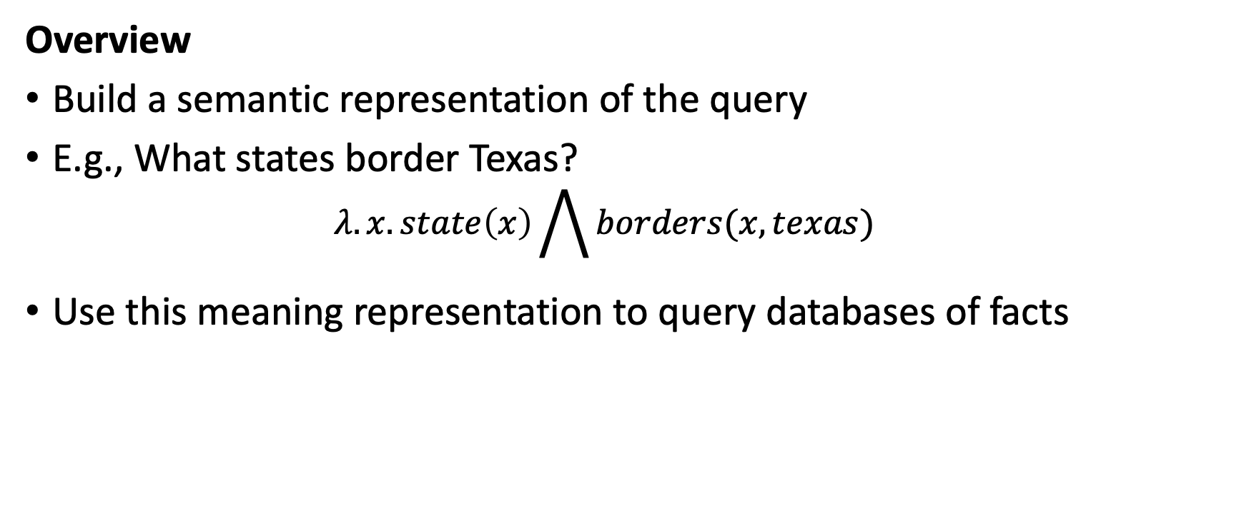
Knowledge-based QA
Overview
Build a semantic representation of the query
E.g., What states border Texas?
$$λ.x.state\left(x\right)\bigwedge{borders(x, texas)}$$
Use this meaning representation to query databases of facts

Slide 5
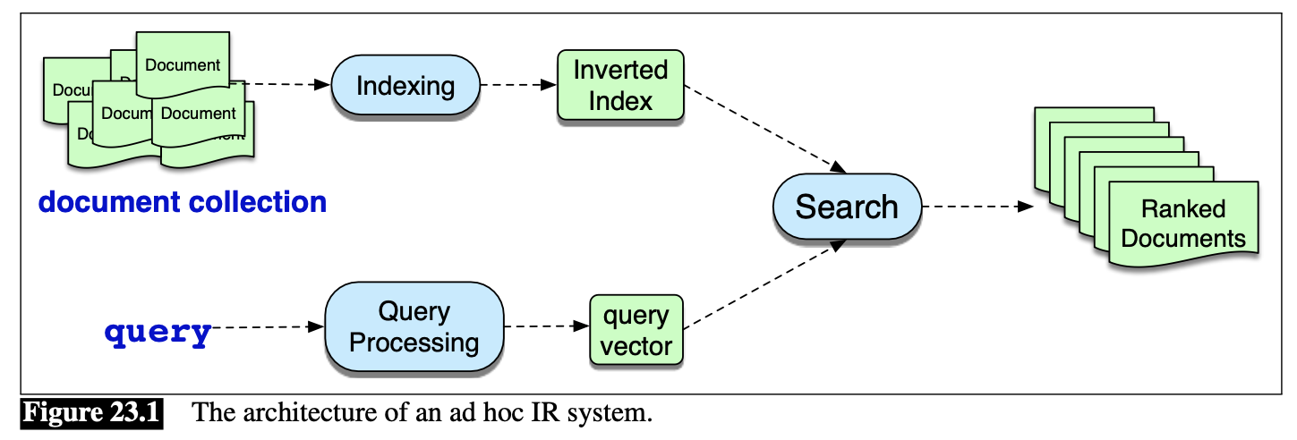
Information-retrieval (IR) based QA
Most well-known IR system: Search Engine!
Task: “ad hoc retrieval”
User poses a query to an IR system
IR system returns an ordered set of documents from some collection

Slide 6
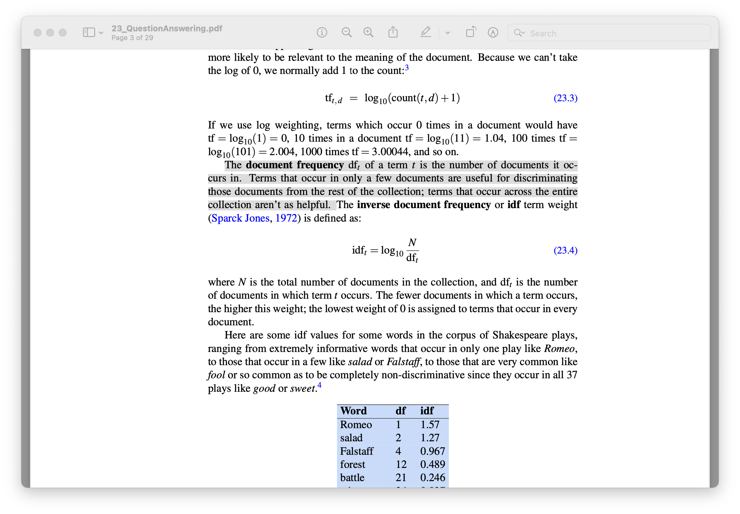
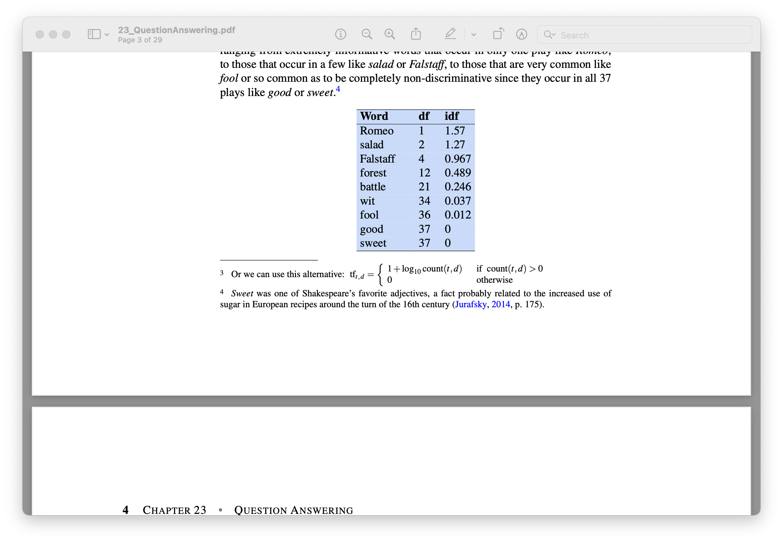
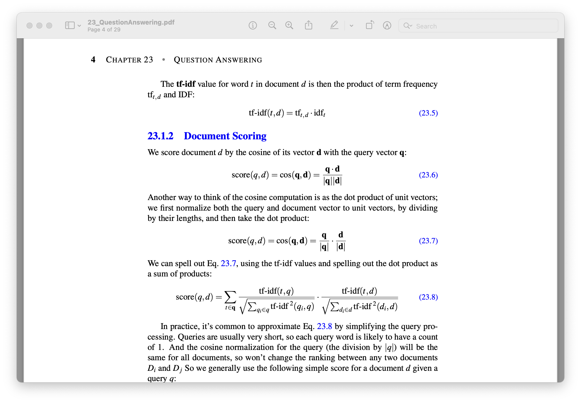
Information-retrieval (IR) based QA
Map queries and document to vectors
Compute cosine similarities between the vectors to rank documents
Common term-weighting scores for the vectors:
TF-IDF weighting (term frequency, inverse document frequency)
Notes:
The term frequency tells us how frequent the word is; words that occur more often in a document are likely to be informative about the document’s contents. We usually use the log10 of the word frequency, rather than the raw count. The intuition is that a word appearing 100 times in a document doesn’t make that word 100 times more likely to be relevant to the meaning of the document.
The document frequency dft of a term t is the number of documents it oc- curs in. Terms that occur in only a few documents are useful for discriminating those documents from the rest of the collection; terms that occur across the entire collection aren’t as helpful.

Slide 7
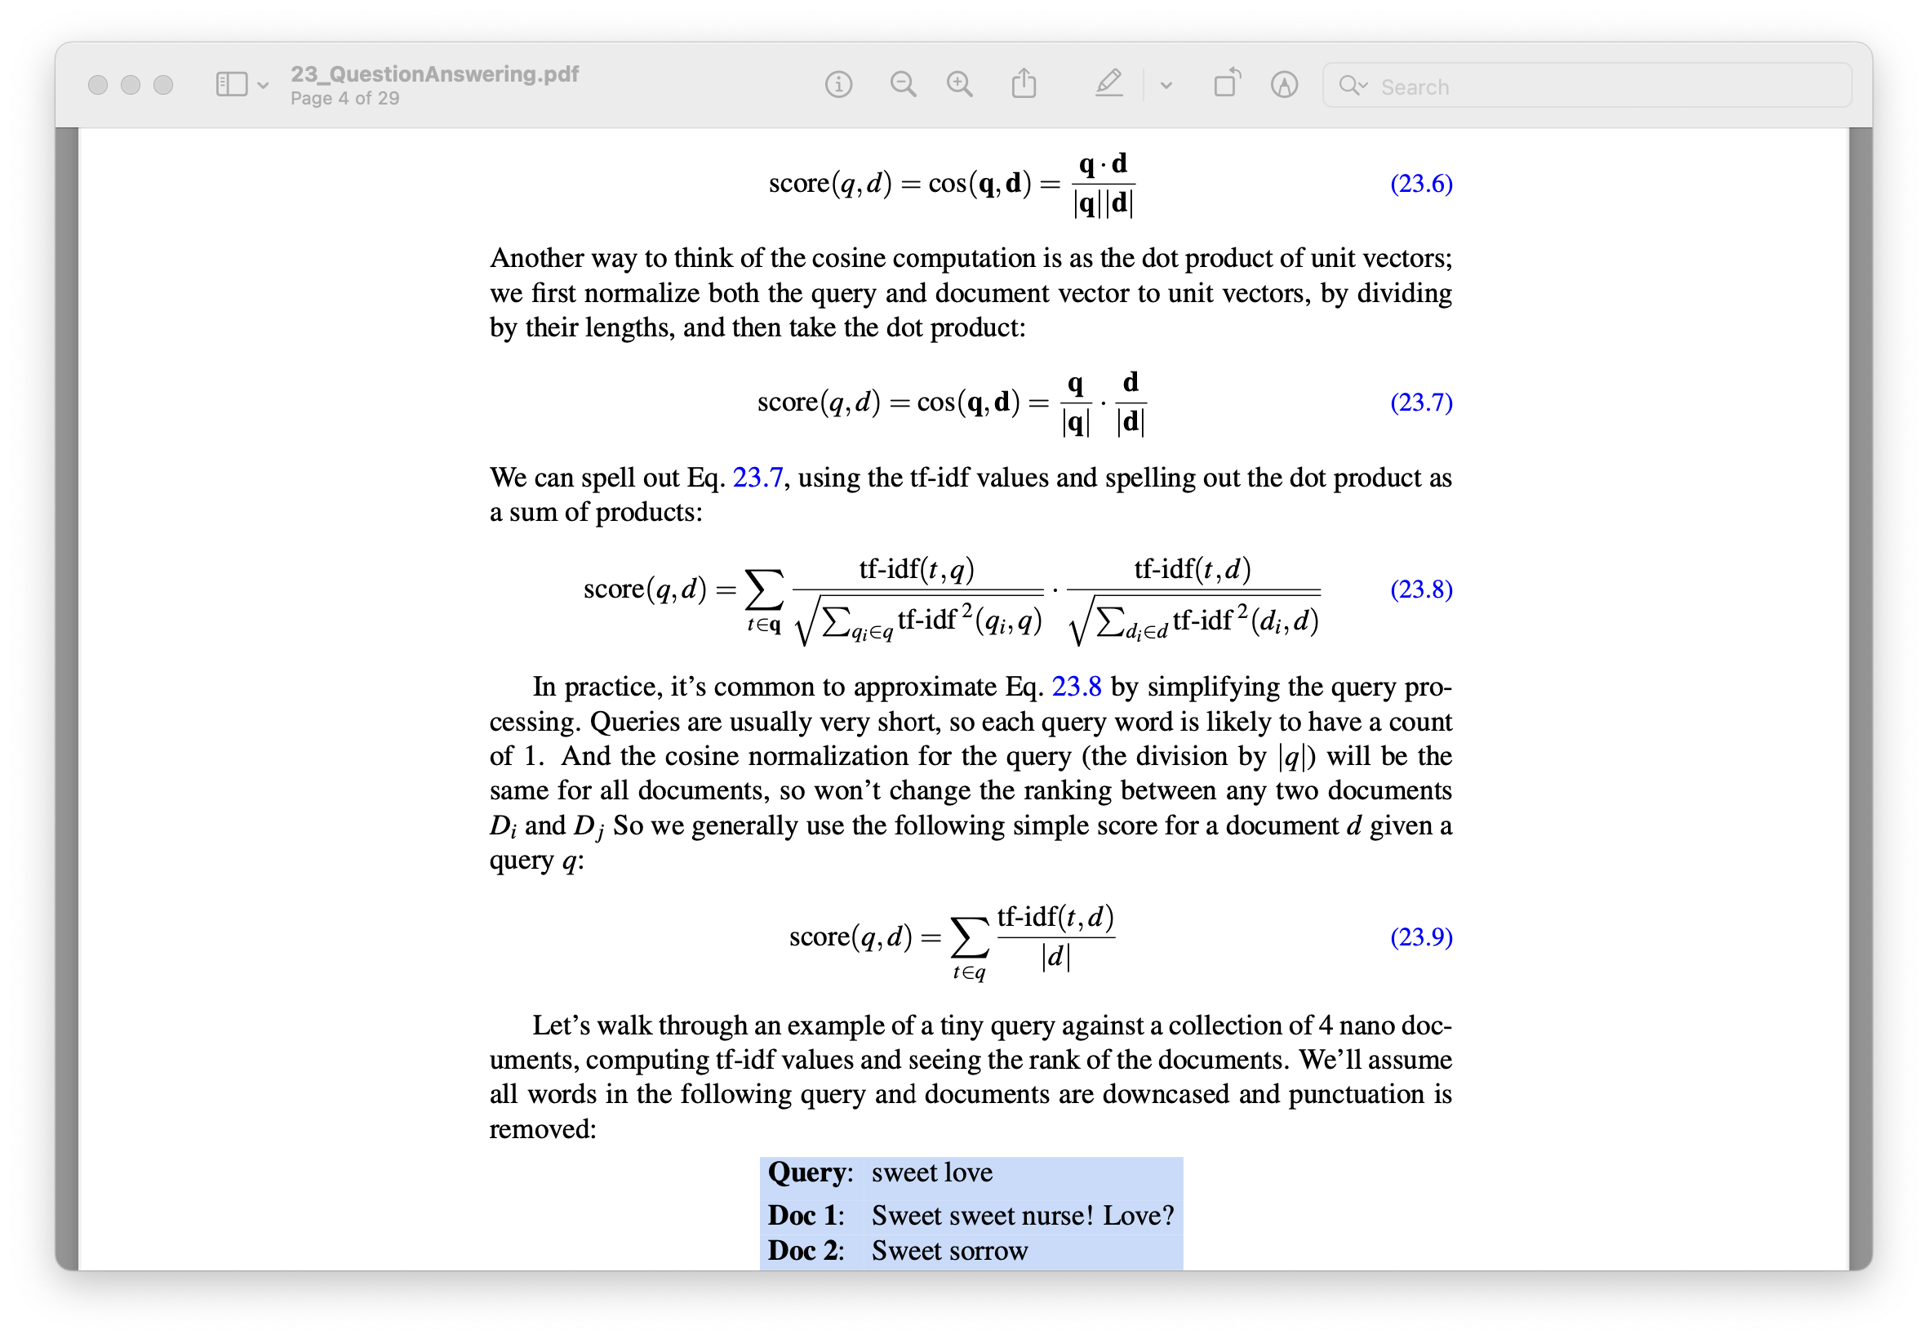
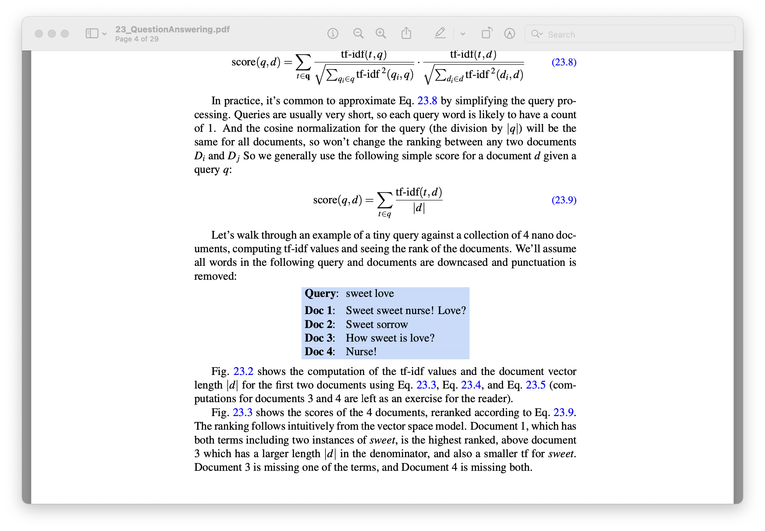
Information-retrieval (IR) based QA
Document scoring
Notes:
In practice, it’s common to approximate by simplifying the query processing. Queries are usually very short, so each query word is likely to have a count of 1. And the cosine normalization for the query (the division by |q|) will be the same for all documents, so won’t change the ranking between any two documents Di and D j So we generally use the following simple score for a document d given a query q:

Slide 8
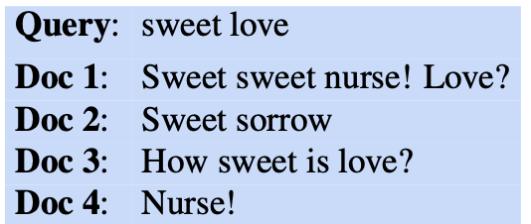
Information-retrieval (IR) based QA
Document scoring walkthrough (preprocessing: document is lowercased, punctuation removed)
How about stop words?

Slide 9
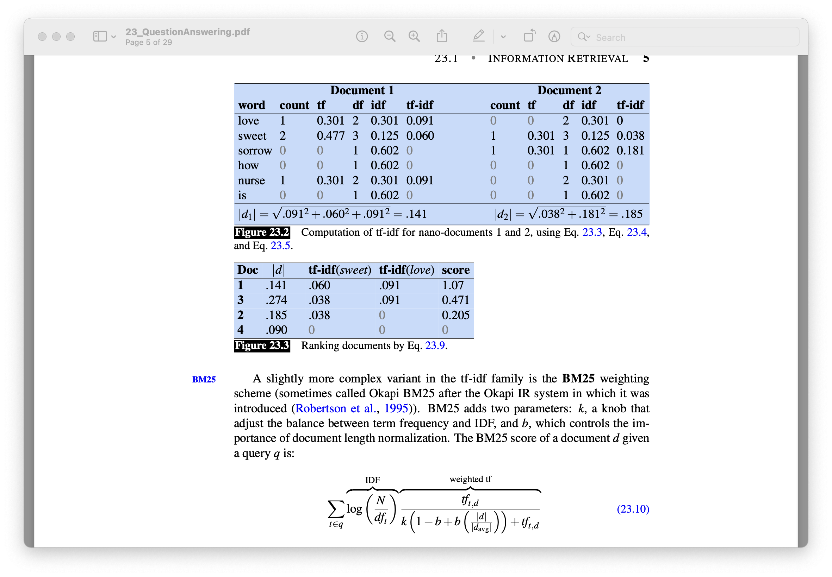
Information-retrieval (IR) based QA
Document scoring walkthrough (preprocessing: document is lowercased, punctuation removed)

Slide 10
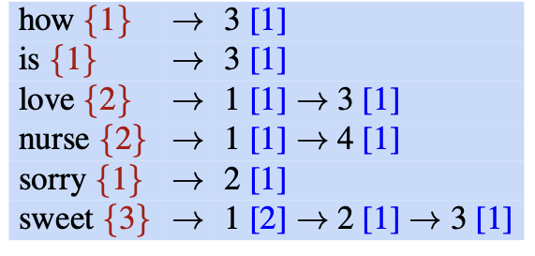
Information-retrieval (IR) based QA
Motivation: we’ll only rank documents that have the query terms
Inverted index is one such data structure (other methods: bigram indexing, efficient hashing, ...)
Given a query term, it will give a list of documents that contain the term
2 parts: dictionary and postings
Notes:
A postings list is the list of document IDs associated with each term, which can also contain information like the term frequency or even the exact positions of terms in the document.

Slide 11
Information-retrieval (IR) based QA
Evaluation
Precision: fraction of returned documents that are relevant
Recall: fraction of all relevant documents that are returned
Need to compare if one IR system ranks the relevant documents higher
Precision_{rank} and Recall_{rank}

Slide 12
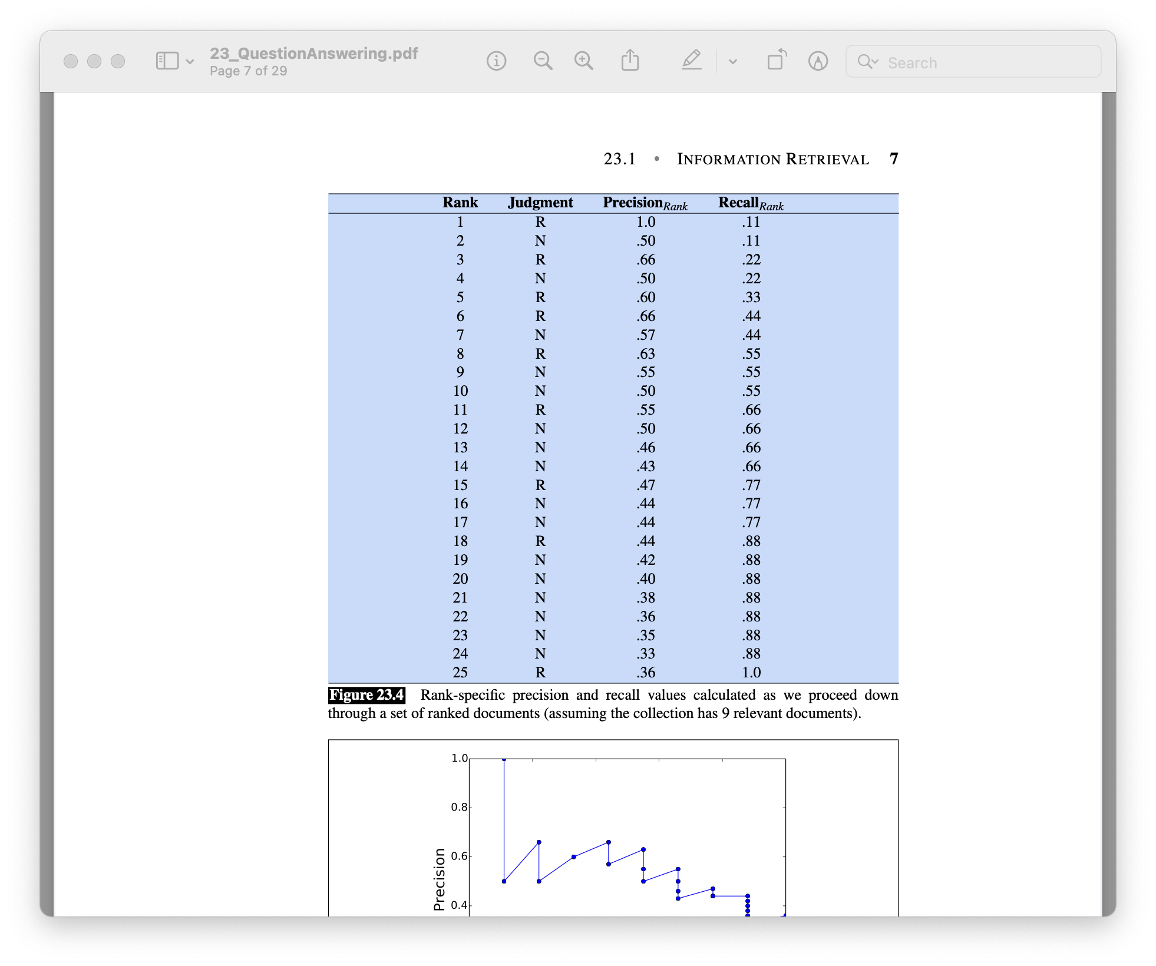
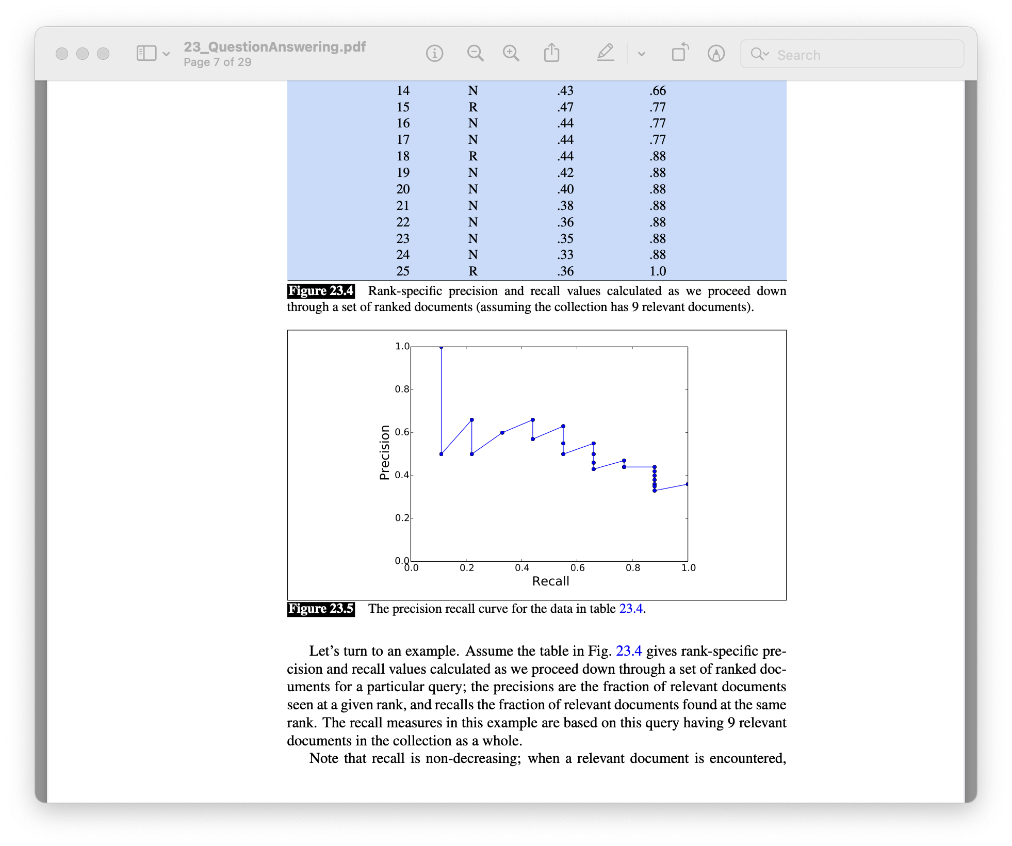
Information-retrieval (IR) based QA
Evaluation
Need to compare if one IR system ranks the relevant documents higher
Precision_{rank} and Recall_{rank}

Slide 13
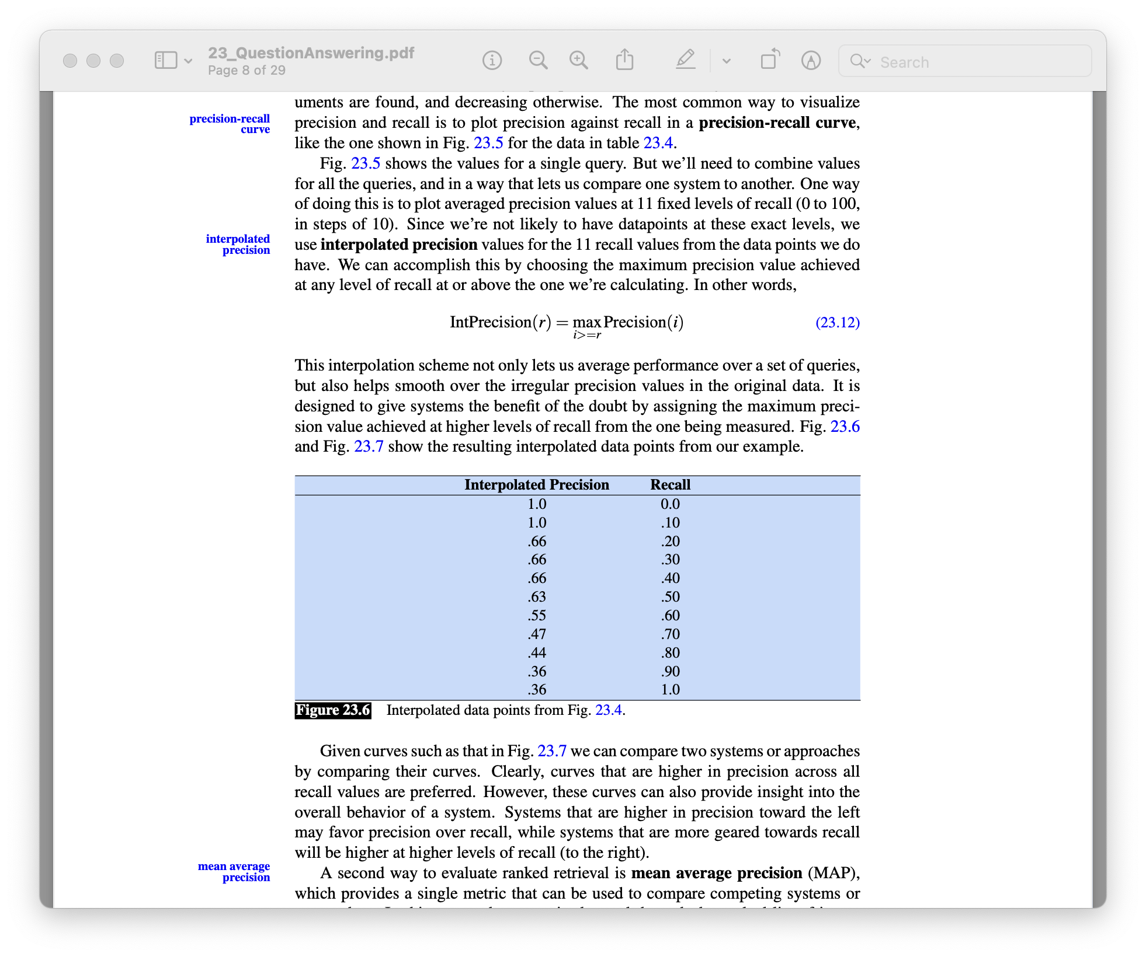
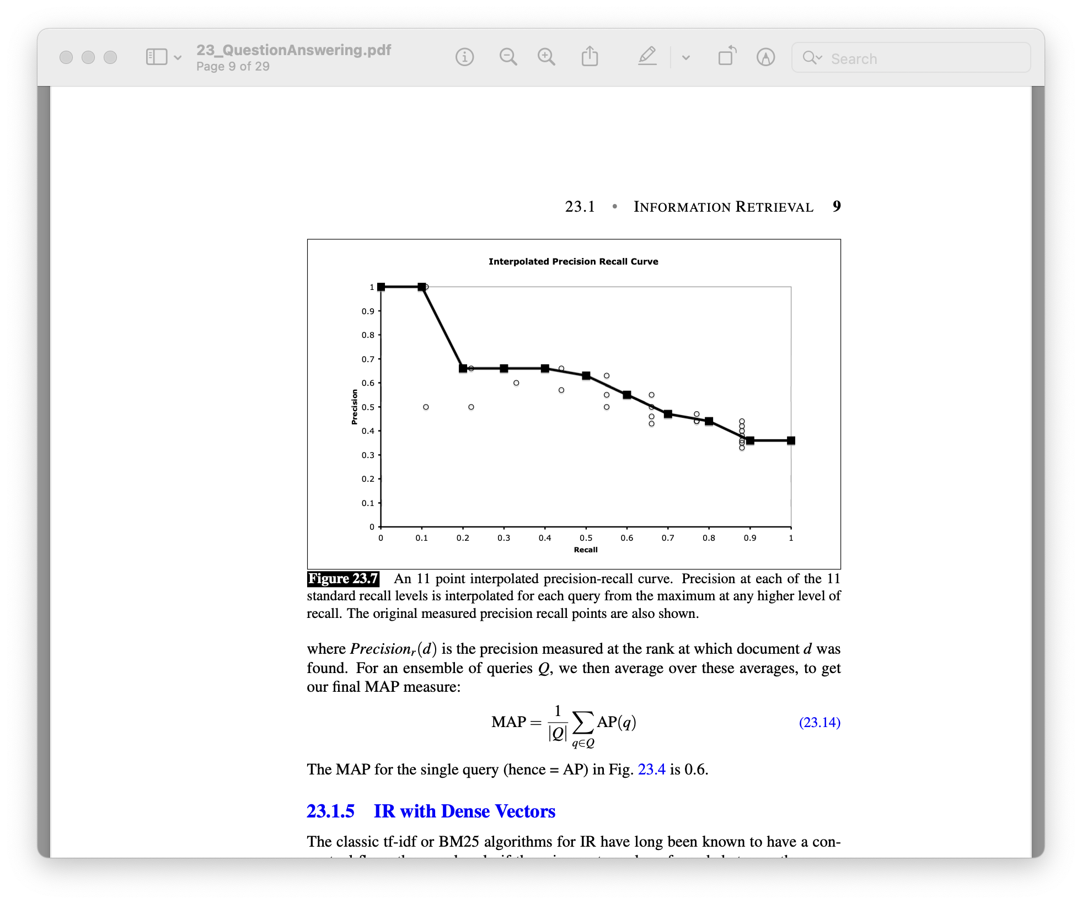
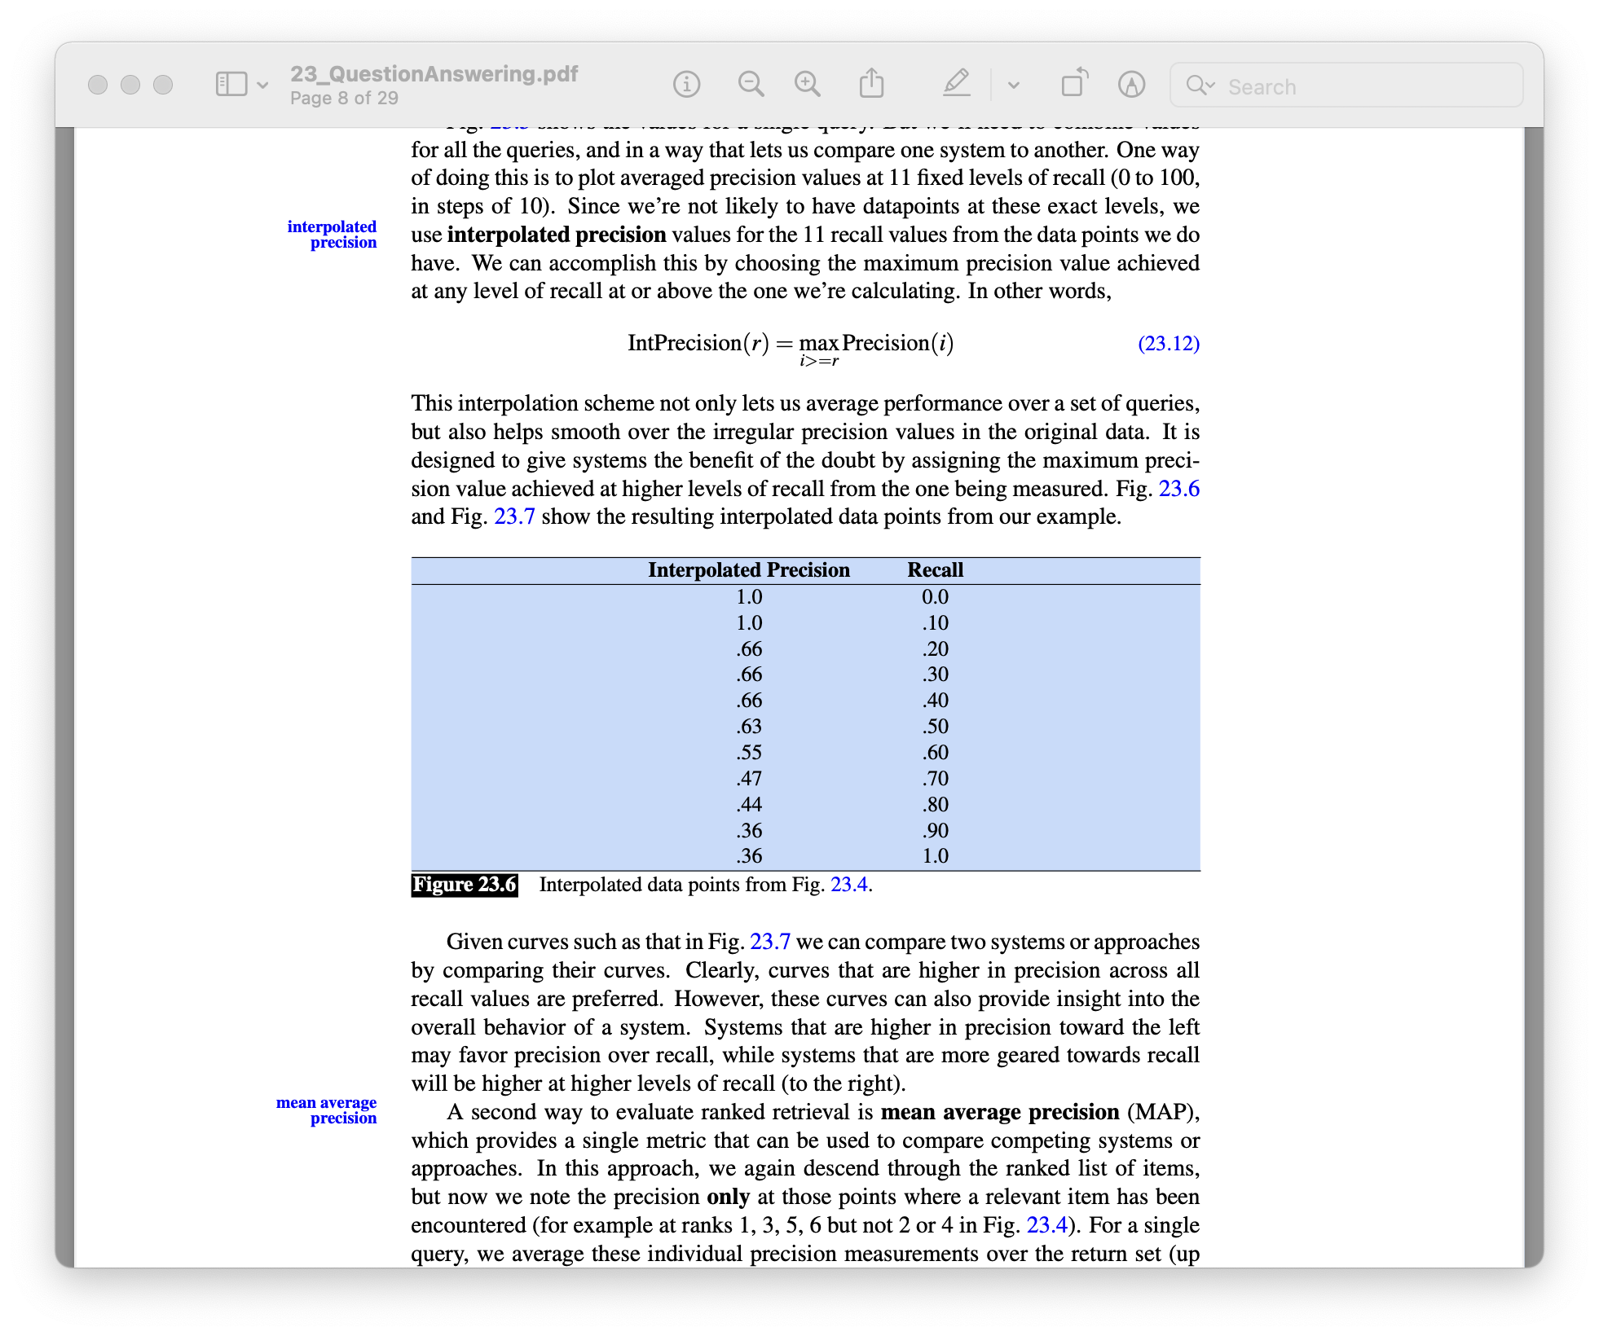
Information-retrieval (IR) based QA
Need to compare if one IR system ranks the relevant documents higher
Precision_{rank} and Recall_{rank}
For multiple queries, can use Interpolated precision
Also smooth out the precision-recall curve
A better IR system is one with higher precision across recall values

Slide 14
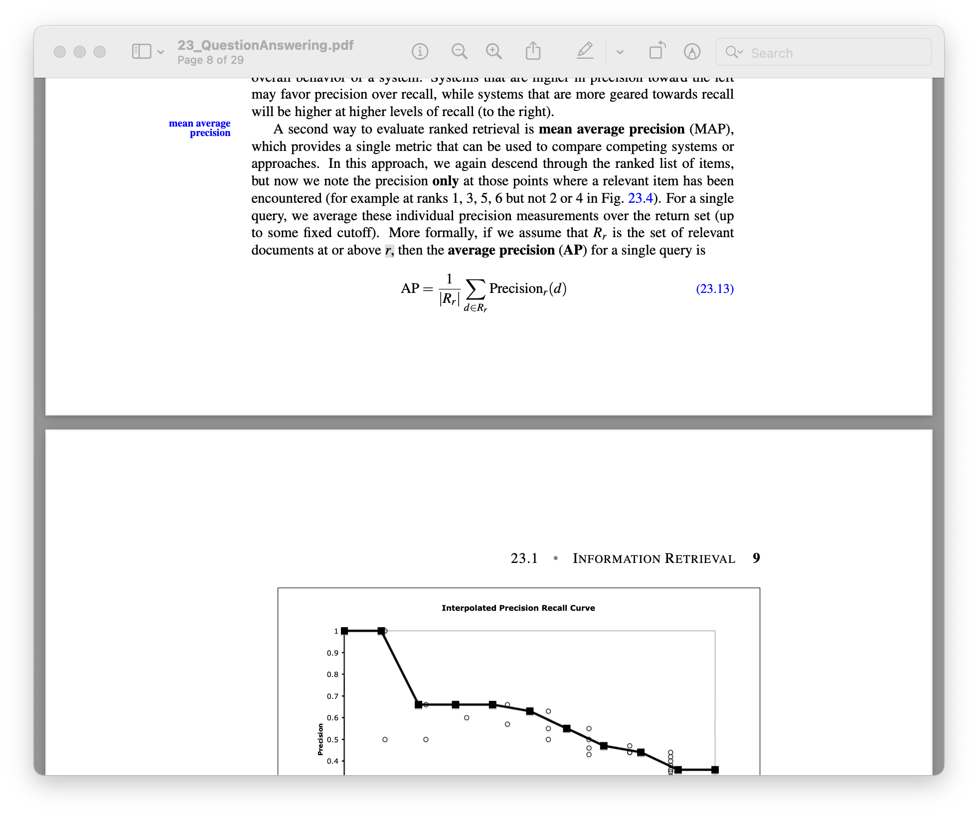
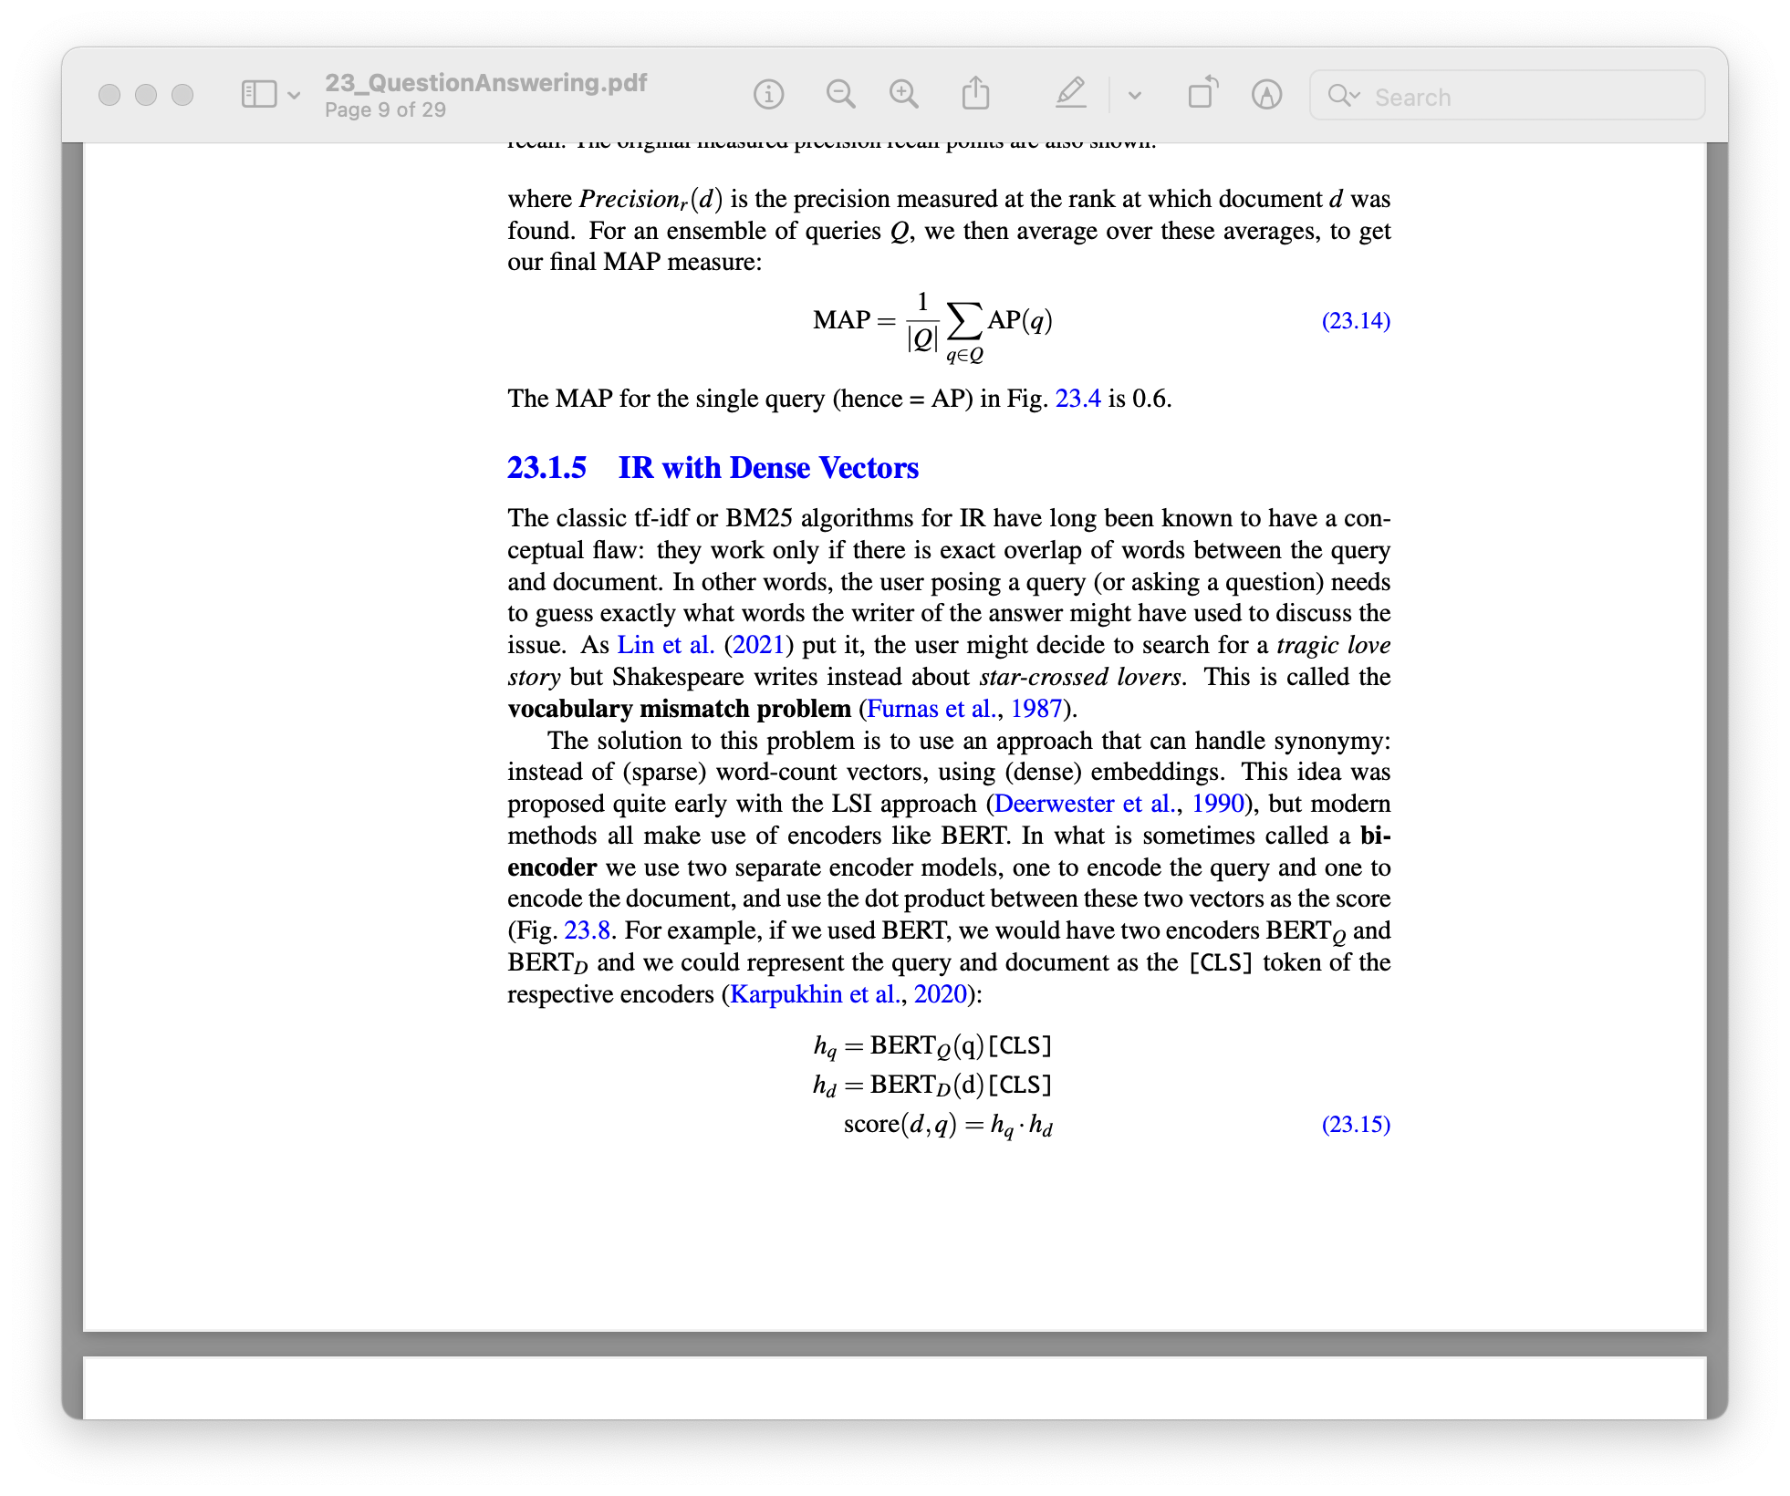
Information-retrieval (IR) based QA
Evaluation
Average Precision (AP) for a single query:
Mean average precision (MAP) for multiple
queries Q:

Slide 15
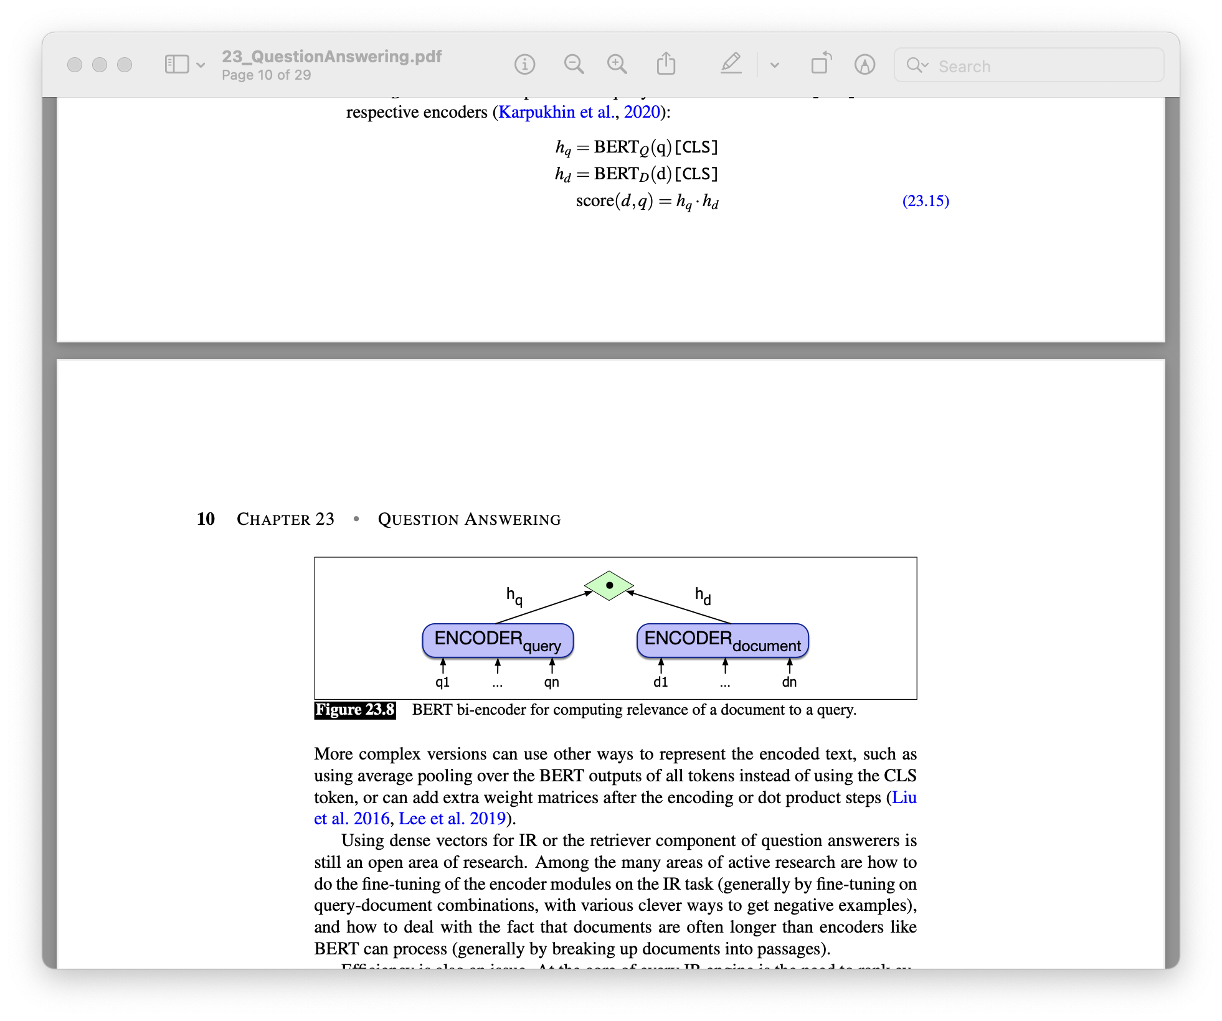
Information-retrieval (IR) based QA
Sparse vectors (TF-IDF) work only if there is exact overlap of words between query and document
E.g., user search for “tragic love story” but Shakespeare writes instead about “star-crossed lovers”
Instead of sparse vectors, use dense embeddings
E.g., BERT
Or average pooling, etc. instead of CLS; how to do fine-tuning of these encoders, ... (Open research area)
Notes:
Using dense vectors for IR or the retriever component of question answerers is still an open area of research. Among the many areas of active research are how to do the fine-tuning of the encoder modules on the IR task (generally by fine-tuning on query-document combinations, with various clever ways to get negative examples), and how to deal with the fact that documents are often longer than encoders like BERT can process (generally by breaking up documents into passages).
Efficiency is also an issue. At the core of every IR engine is the need to rank ev- ery possible document for its similarity to the query. For sparse word-count vectors, the inverted index allows this very efficiently. For dense vector algorithms like those based on BERT or other Transformer encoders, finding the set of dense document vectors that have the highest dot product with a dense query vector is an example of nearest neighbor search. Modern systems therefore make use of approximate nearest neighbor vector search algorithms like Faiss (Johnson et al., 2017).

Slide 16
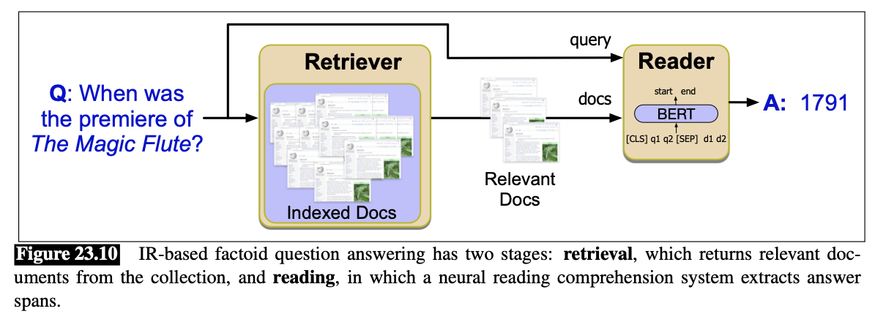
Information-retrieval (IR) based QA
What we saw so far:
Retrieval process
Next stage is to do the reading or neural comprehension process
Find spans of text that are likely to answer the question (reading comprehension task)
Open Domain QA
-- retrieve
-- read

Slide 17
Information-retrieval (IR) based QA
Reading comprehension datasets
Tuples of (passage, question, answer)
Train a model so that given a passage and a question, it predicts a span in the passage as the answer
SQUAD: Stanford Question Answering Dataset
Passages from Wikipedia and associated questions whose answers are spans in the passage
Add some questions that are unanswerable
150K questions
HotpotQA dataset
Multiple documents are shown to annotators are context and they are asked to come up with questions that require reasoning about all of the documents

Slide 18
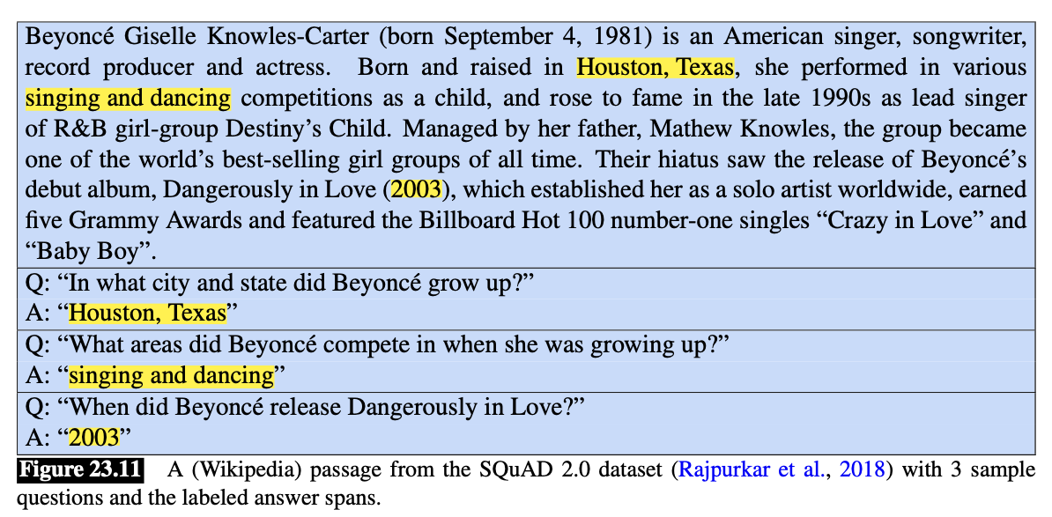
Information-retrieval (IR) based QA
POTENTIAL BIAS: Annotators read the passage before writing the questions, so they may use some words from the answer itself in their questions
Reading comprehension datasets
SQUAD
So: TriviaQA dataset, Natural Questions dataset, ...
Most of the dataset is also in English! So: TyDi QA
Notes:
The TyDi QA dataset contains 204K question-answer pairs from 11 typologically diverse languages, including Arabic, Bengali, Kiswahili, Russian, and Thai (Clark et al., 2020). In the TYDI QA task, a system is given a question and the passages from a Wikipedia article and must (a) select the passage containing the answer (or NULL if no passage contains the answer), and (b) mark the minimal answer span (or NULL). Many questions have no answer. The various languages in the dataset bring up challenges for QA systems like morphological variation between the question and the answer, or complex issue with word segmentation or multiple alphabets.

Slide 19
Information-retrieval (IR) based QA
Reading comprehension task
”Extractive QA”: the answer is a span of text in the passage
Span labeling: identifying in the passage a span (a continuous string of text) that constitutes an answer.

Slide 20
Information-retrieval (IR) based QA
Reading comprehension task
”Extractive QA”: Span labeling
Given a question q of n tokens: q₁, ..., q_{n} and a passage p of m tokens p₁, ... p_{m}, goal is to compute P(a|q, p) that each possible span a is the answer
Simplifying:
For each token p_{i} in the passage, compute two probabilities:
p_{start}(i): the probability that p_{i} is the start of the answer span
p_{end}(i): the probability that p_{i} is the end of the answer span

Slide 21
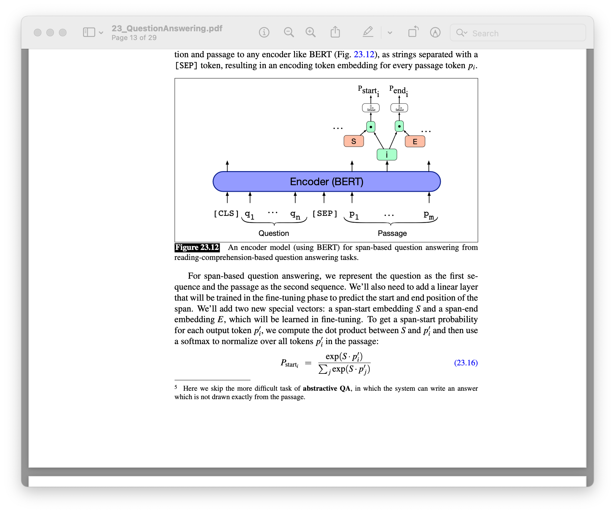
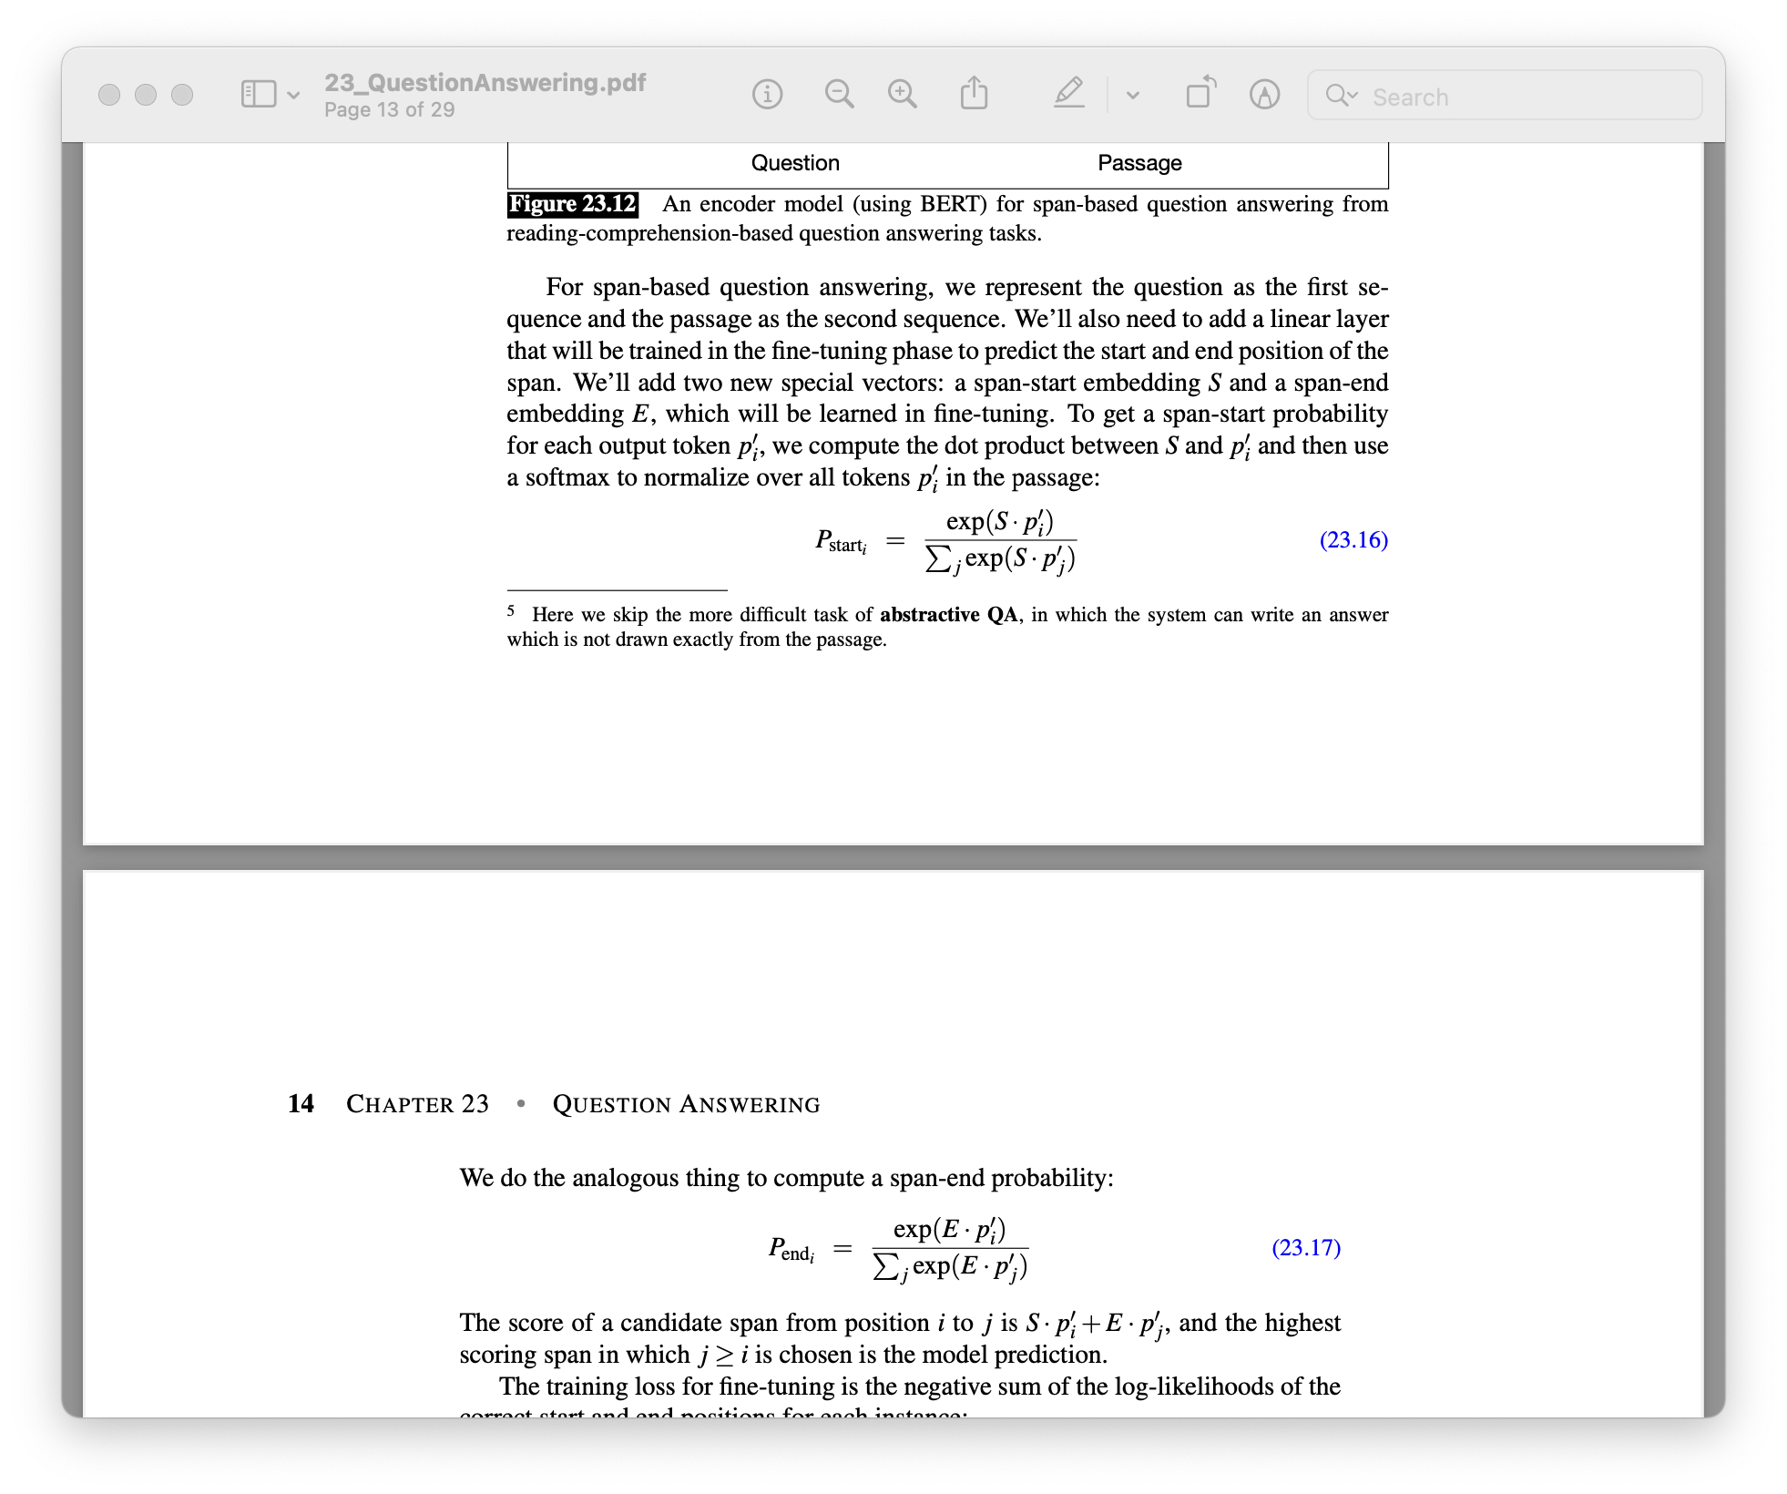
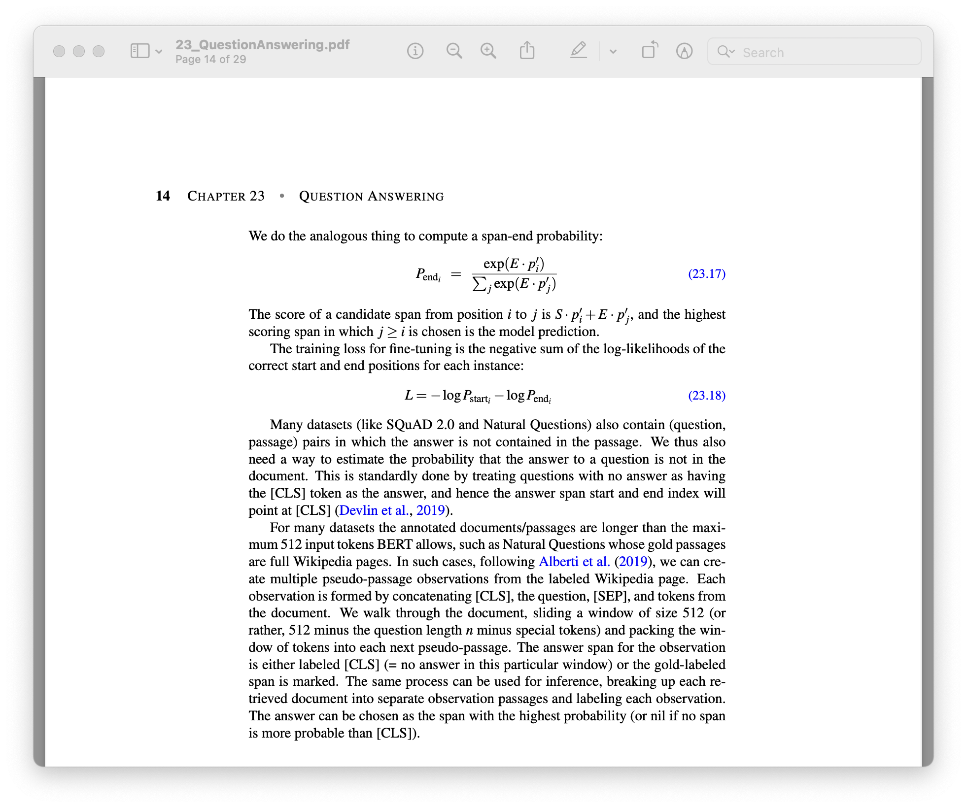
Information-retrieval (IR) based QA
Extractive QA
For each token p_{i} in the passage, compute two probabilities:
p_{start}(i): the probability that p_{i} is the start of the answer span
p_{end}(i): the probability that p_{i} is the end of the answer span
Notes:
The score of a candidate span from position i to j is S· p′i +E · p′j , and the highest ij
scoring span in which j ≥ i is chosen is the model prediction.
Many datasets (like SQuAD 2.0 and Natural Questions) also contain (question, passage) pairs in which the answer is not contained in the passage. We thus also need a way to estimate the probability that the answer to a question is not in the document. This is standardly done by treating questions with no answer as having the [CLS] token as the answer, and hence the answer span start and end index will point at [CLS]

Slide 22
Knowledge-base QA
But before,
Entity Linking
Task of associating a mention in text with the representation of some real-world entity in an ontology
If that ontology is Wikipedia (each wiki page is an entity), this task is also known as “Wikification”
Roughly two stages:
Mention detection
Mention disambiguation

Slide 23
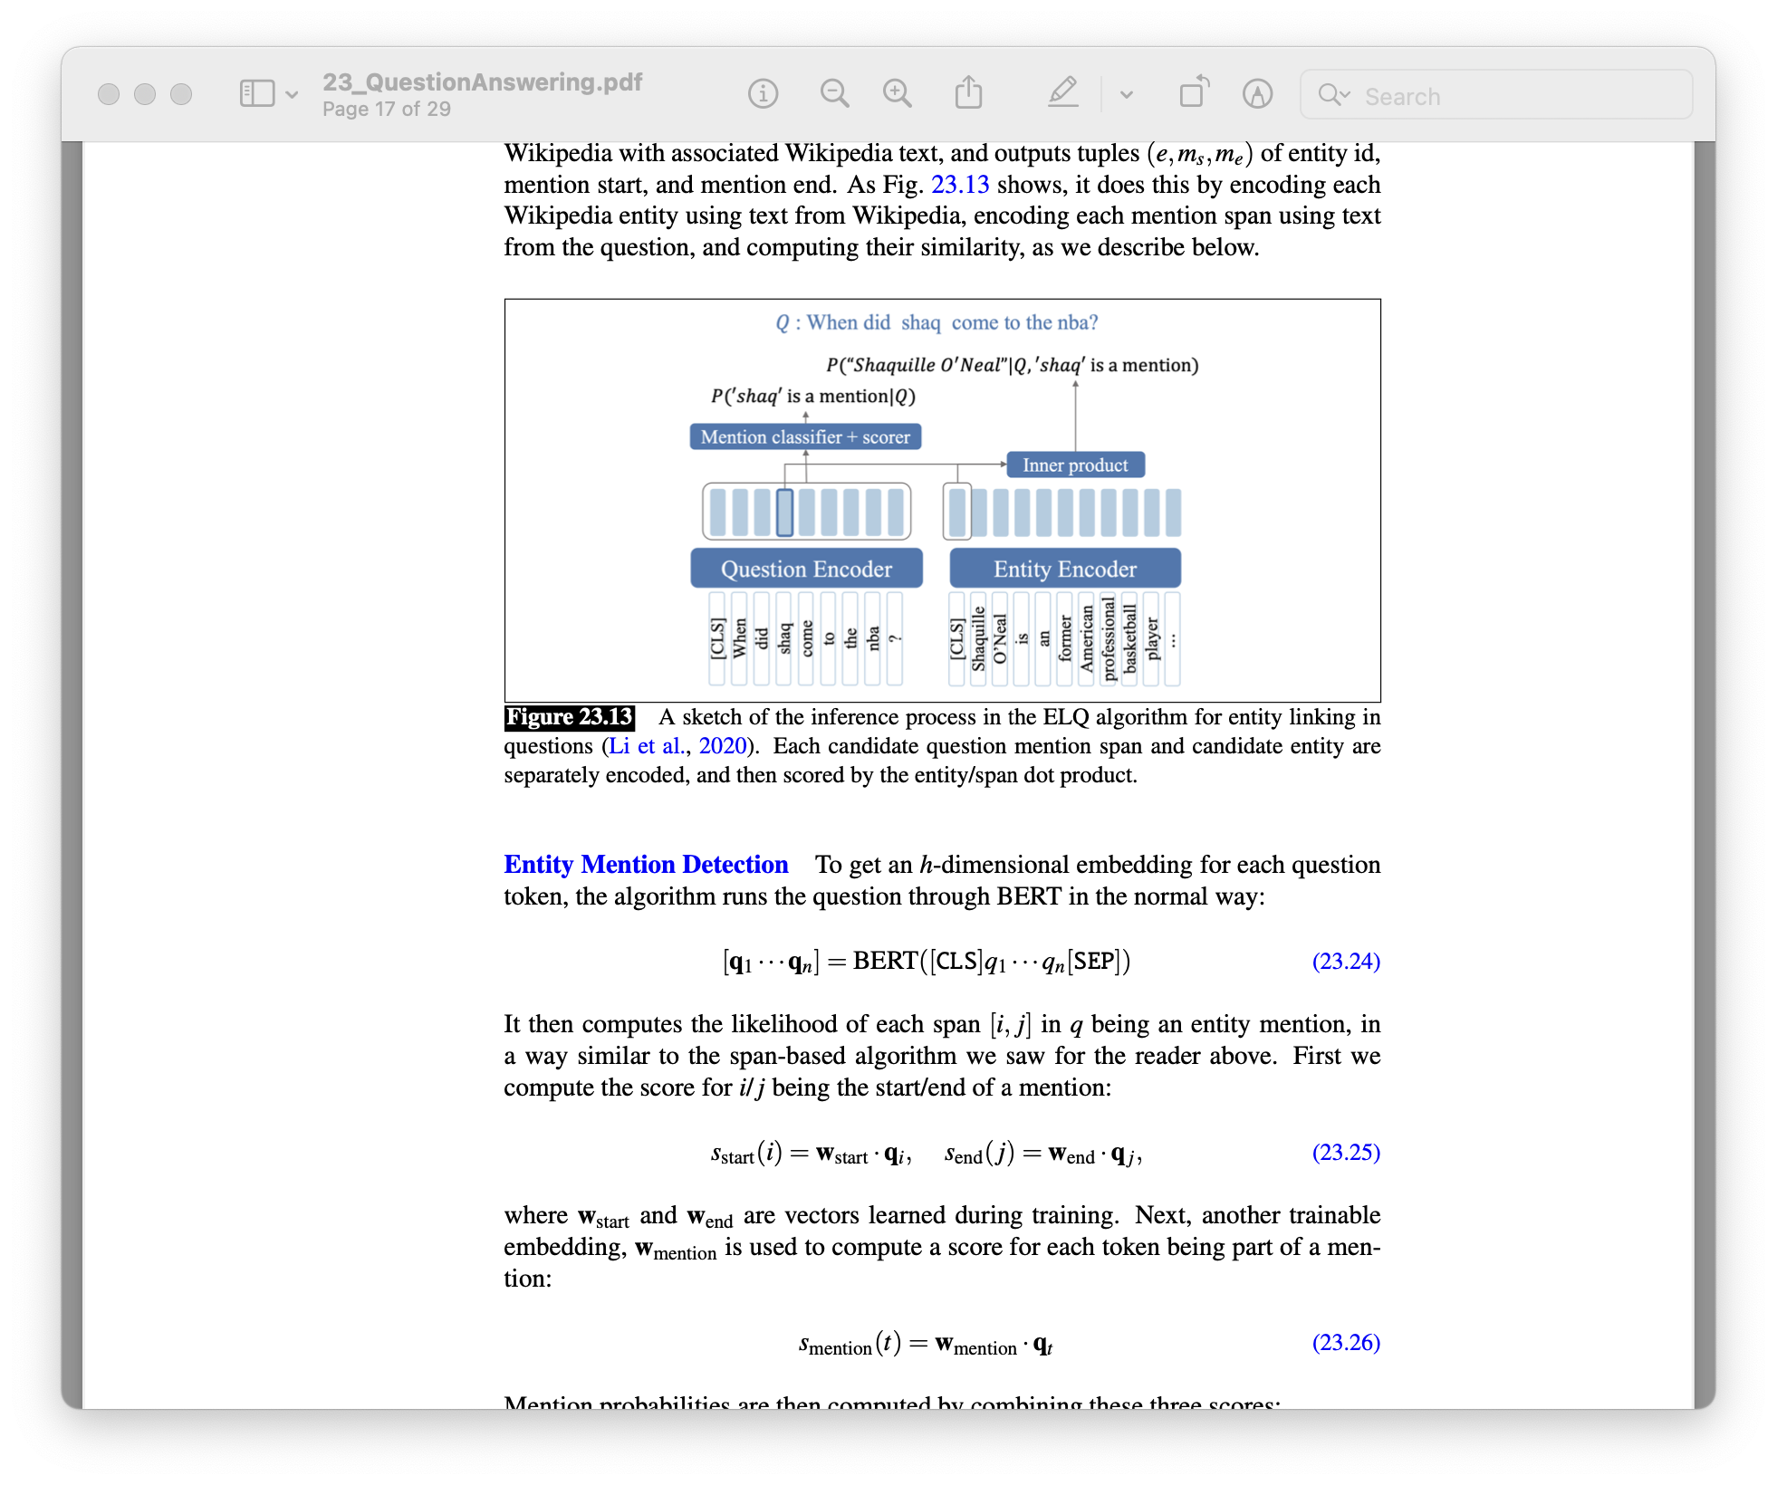
Entity Linking
ELQ algorithm
Entity mention
detection
Entity Linking

Slide 24
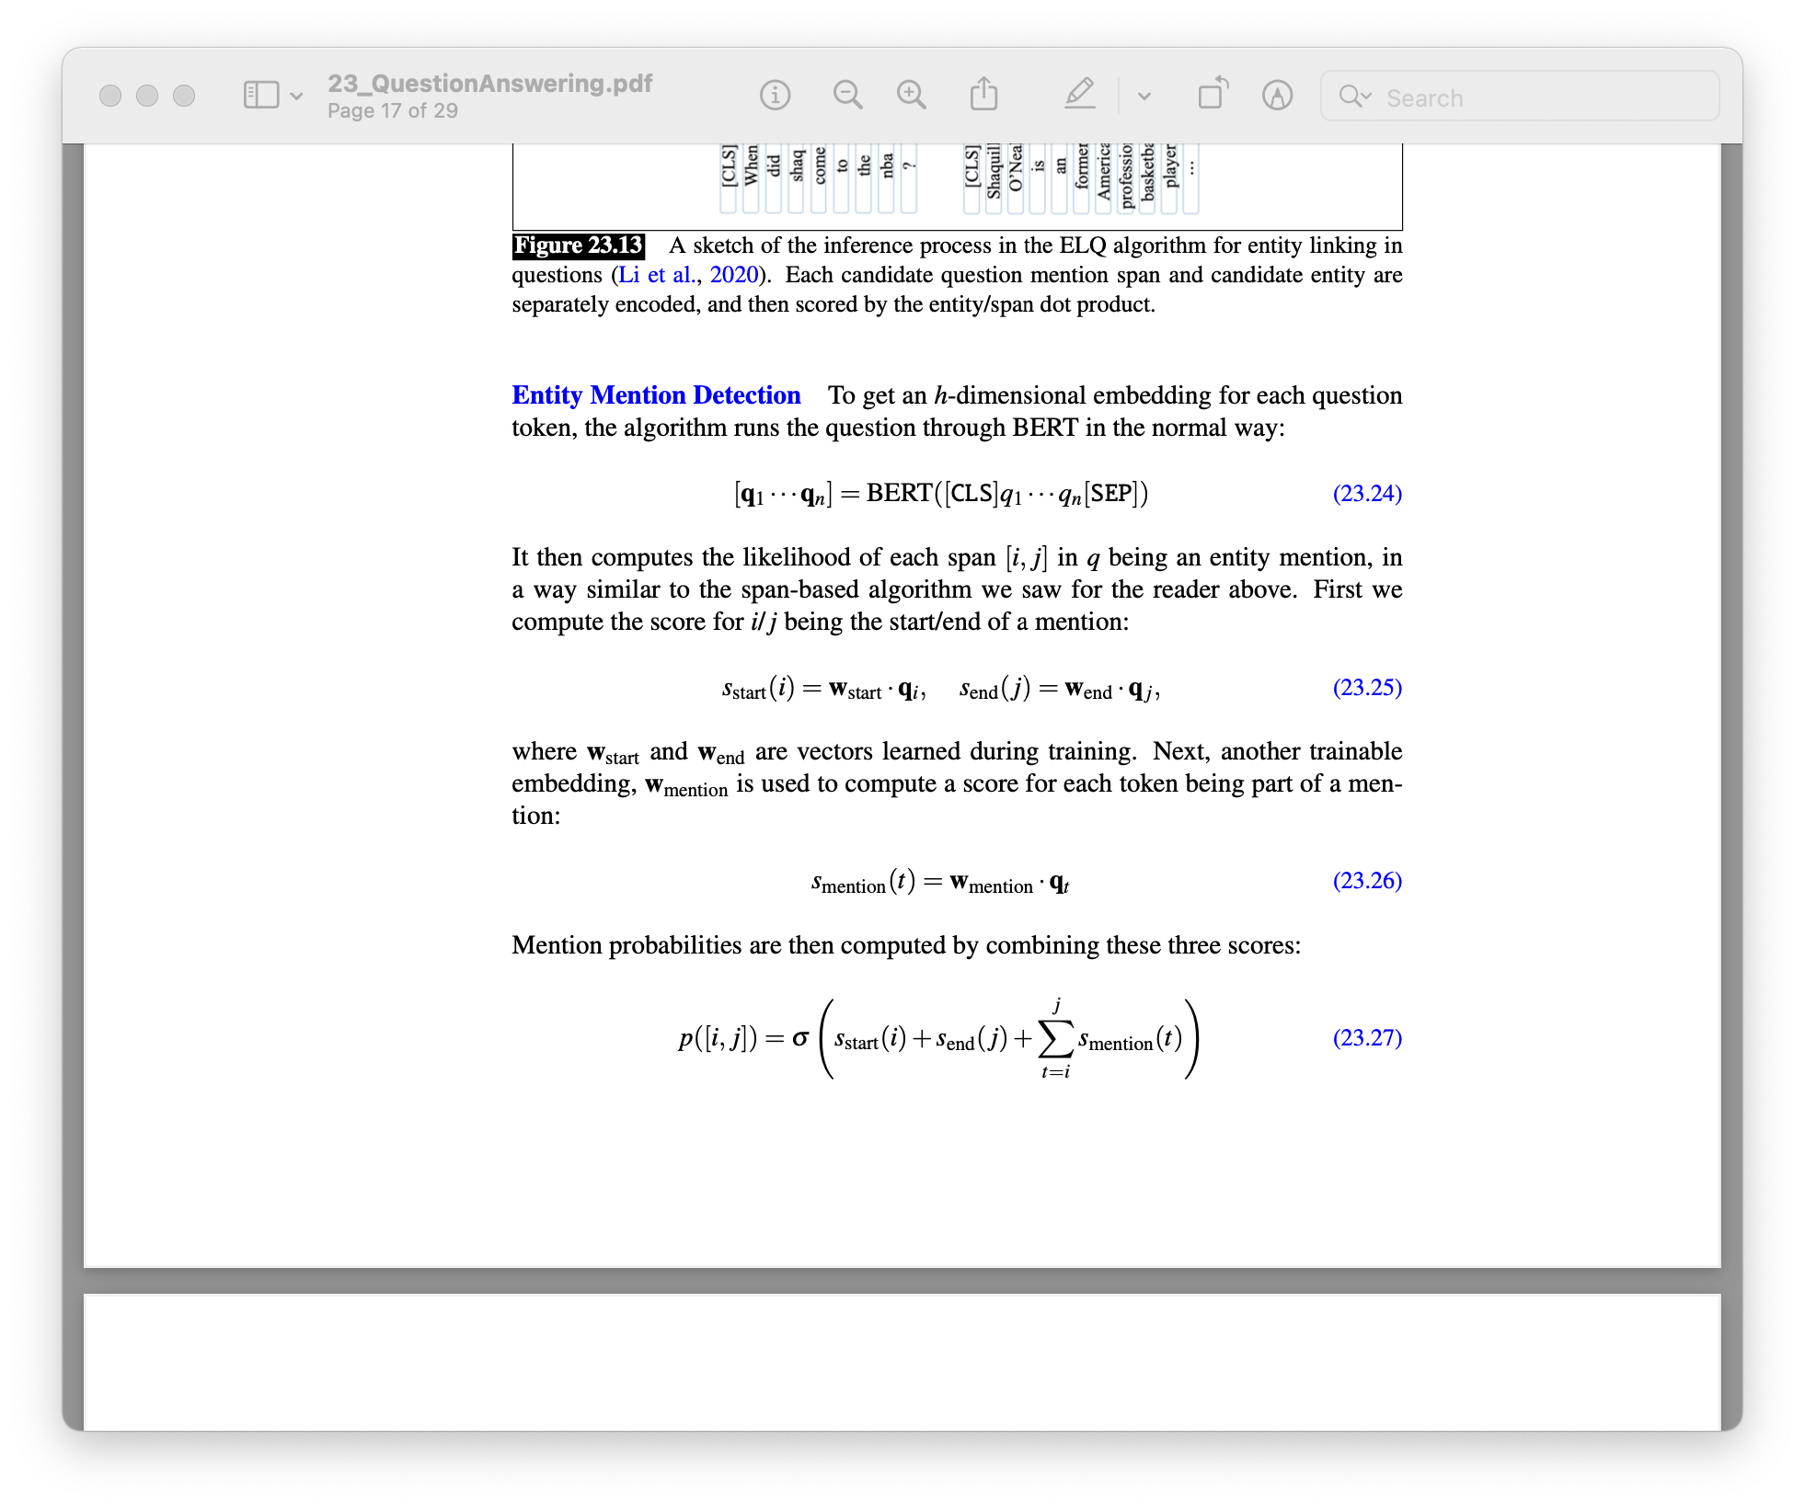
Entity Linking
ELQ algorithm: entity mention detection

Slide 25
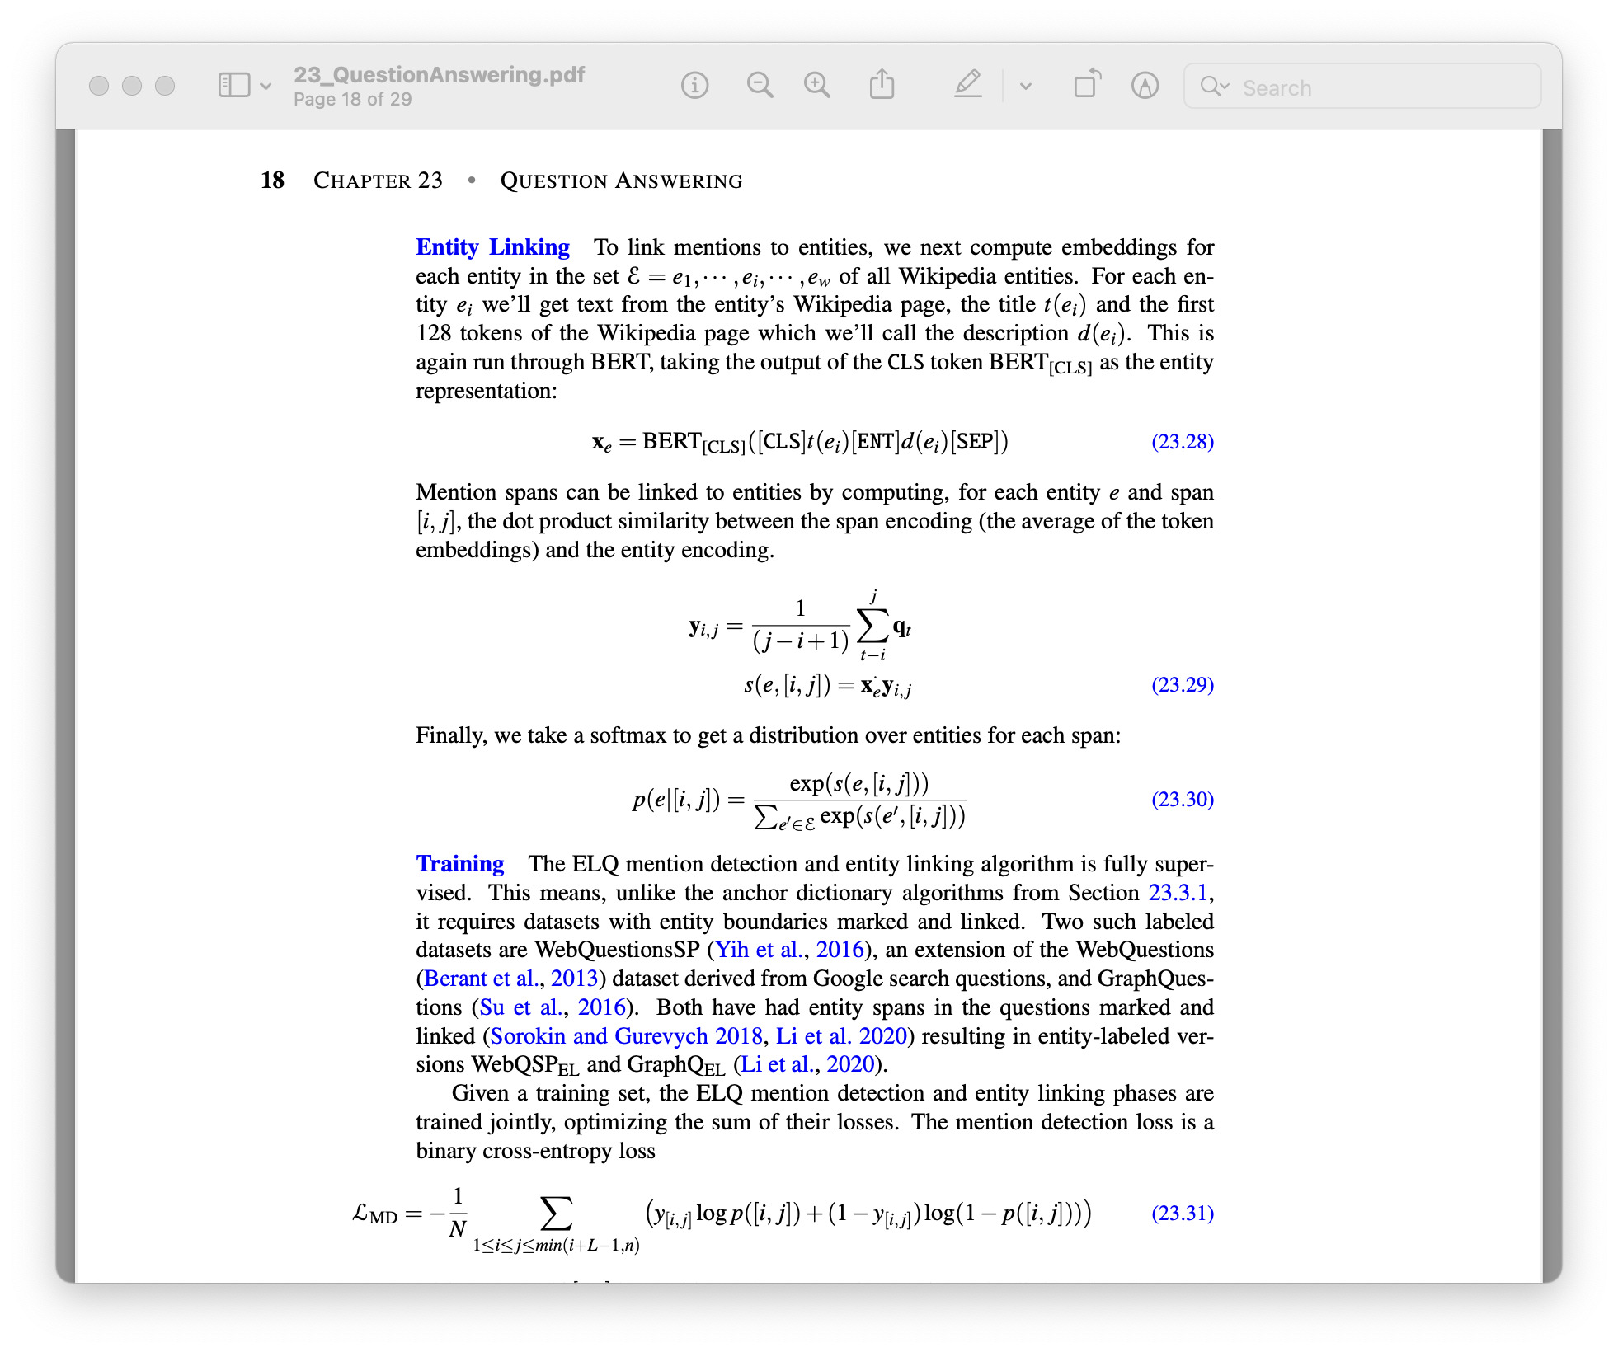
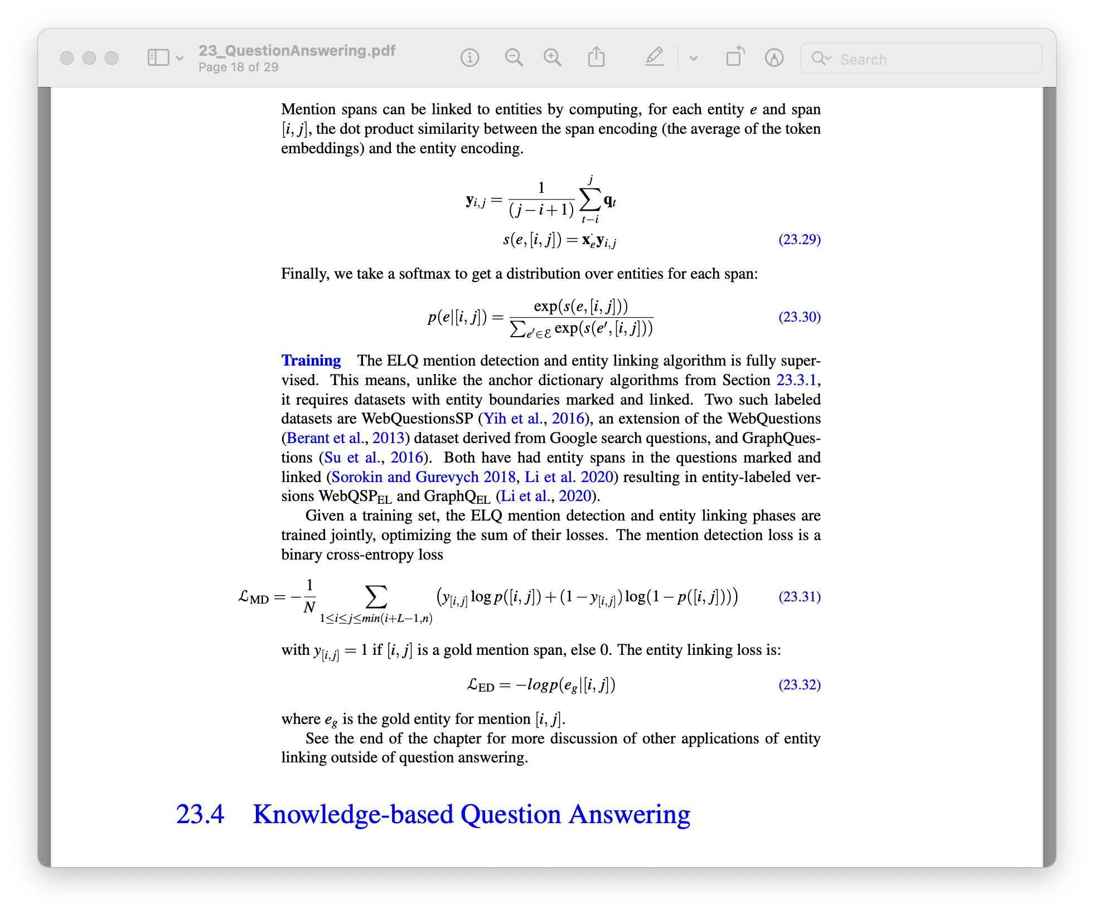
Entity Linking
ELQ algorithm: entity linking
For each entity,
Get the title and the first 128 tokens of the Wikipedia page
Probability that a span [i, j] corresponds to an entity e, P(e|[i,j])
Notes:
Mention spans can be linked to entities by computing, for each entity e and span [i, j], the dot product similarity between the span encoding (the average of the token embeddings) and the entity encoding.
Finally, we take a softmax to get a distribution over entities for each span:

Slide 26
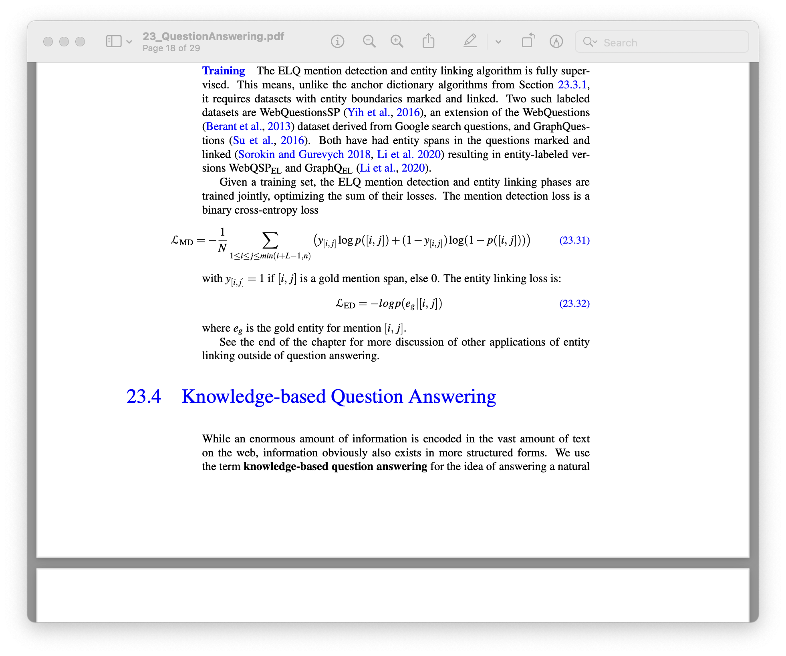
Entity Linking
ELQ algorithm training
Train the entity mention detection and entity linking jointly
Optimize sum of their losses:

Slide 27
Knowledge base QA
Two common paradigms:
Graph-based QA
What we’ve seen before: entities as nodes, relations as edges
QA by semantic parsing
Use semantic parsing methods
Both require entity linking

Slide 28
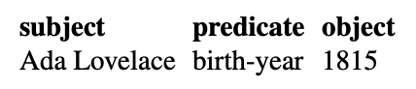
Knowledge base QA
Graph-based QA
Given RDF triples in knowledge base (subject, predicate, object), we can use these triples to answer questions
Can answer questions like “when was Ada Lovelace born?” or “who was born in 1815?”
e.g., FreebaseQA dataset, SimpleQuestions dataset, WebQuestions dataset, ...

Slide 29
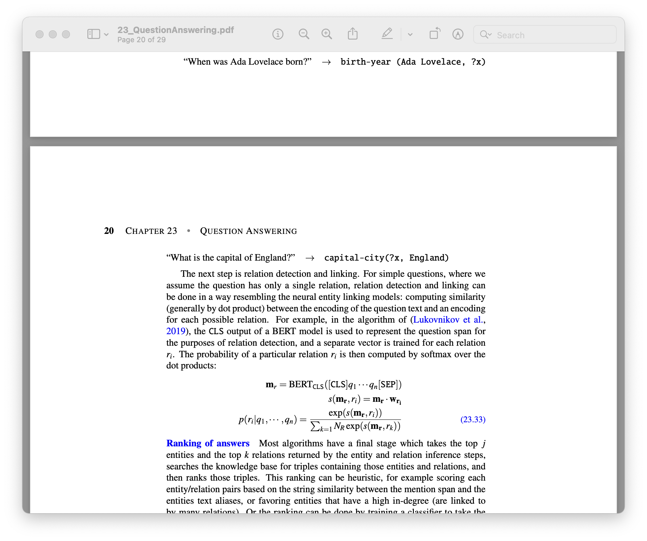
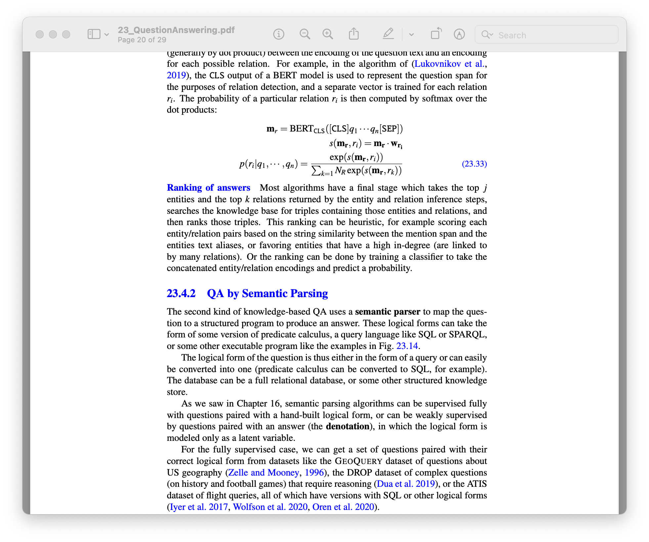
Knowledge base QA
Graph-based QA
Entity linking
Relation detection and linking
Separate vector trained for each relation r_{i}

Slide 30
Knowledge base QA
QA by semantic parsing
Use semantic parser to map the question to a structured program
Program is then run to produce answer
Trained on tuples consisting of questions and their logical forms: GeoQuery dataset, DROP dataset, ATIS dataset (flight queries → SQL forms)

Slide 31
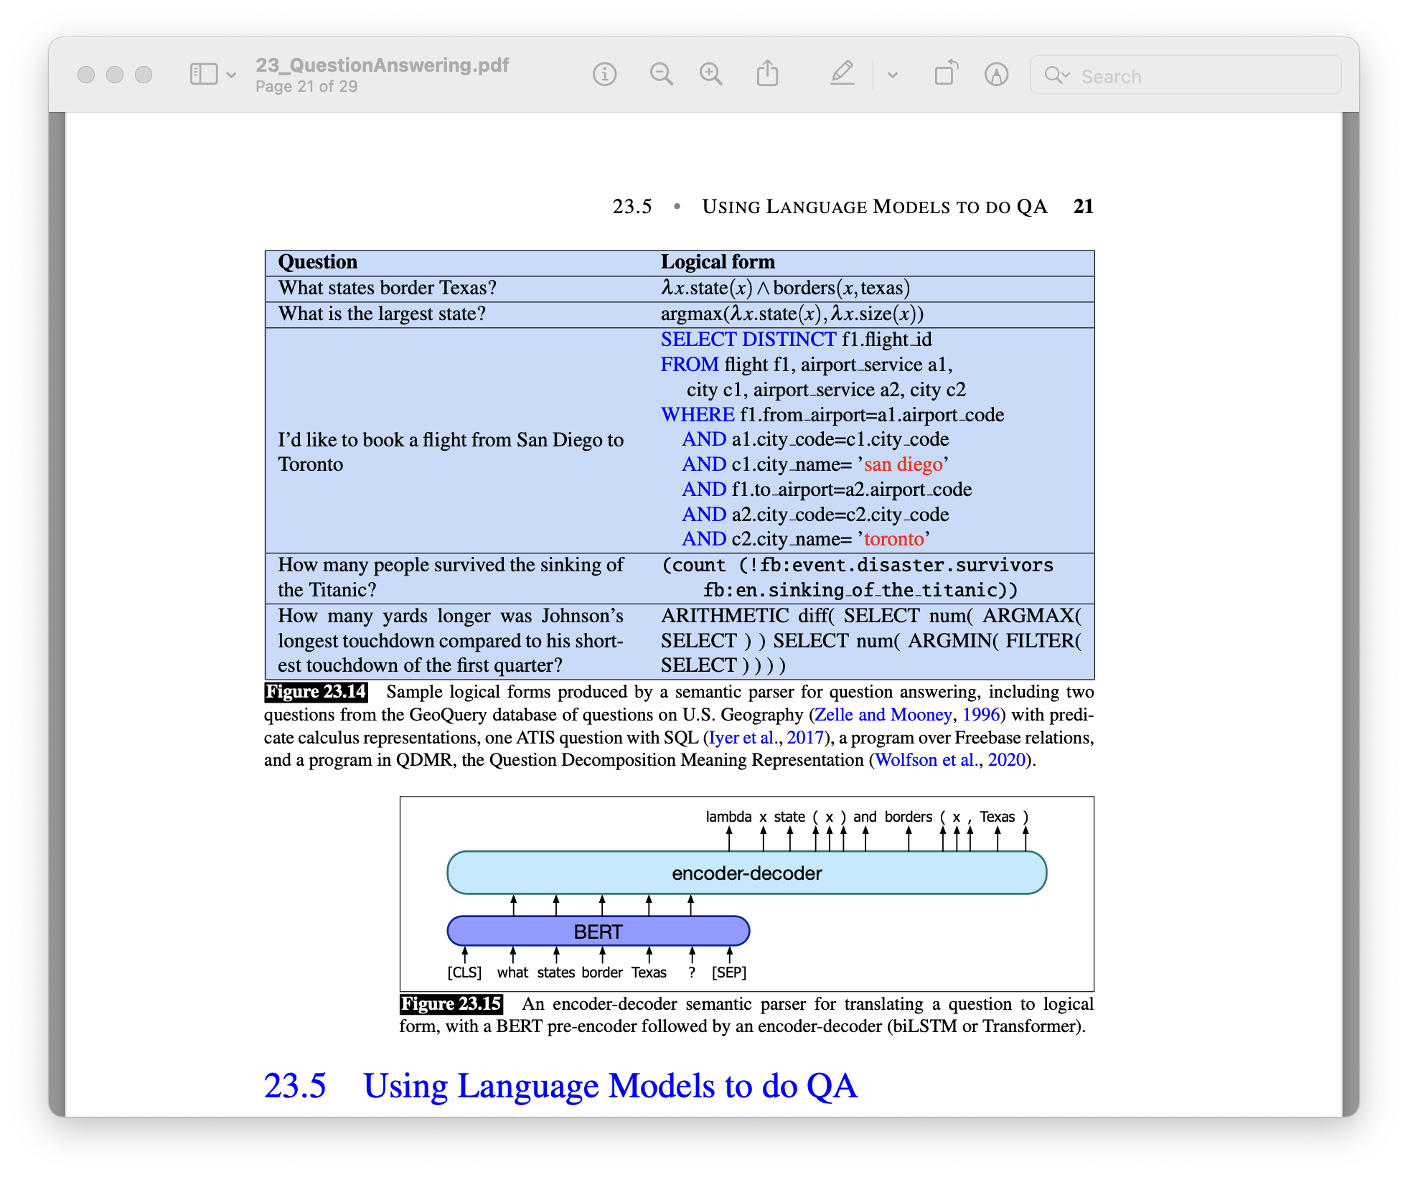
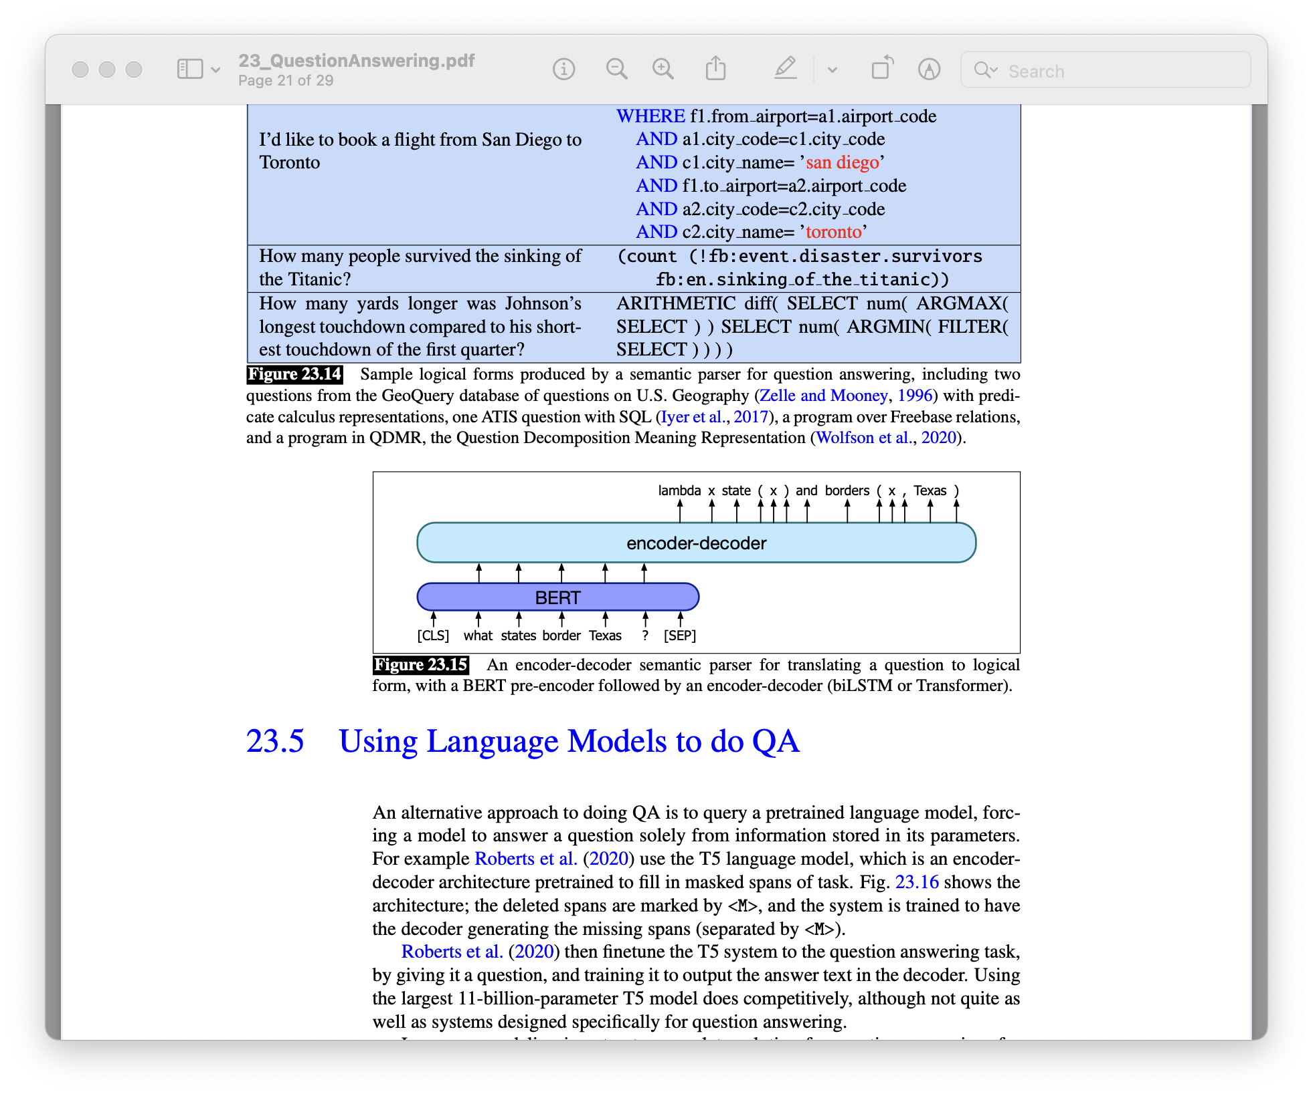
Knowledge base QA
QA by semantic parsing

Slide 32
Other QA approaches
Using Language Model for QA
Classical QA approach

Slide 33
Language Model – based QA
Query a pre-trained language model (LM)
Force the LM to answer a question based on information stored in its parameters
T5 LM: encoder-decoder based architecture
For QA, fine-tune by giving it a question and training it to output the answer in the decoder
But does not perform as well as systems designed specifically for QA, poor interpretability, no evidence given for answers, ...

Slide 34
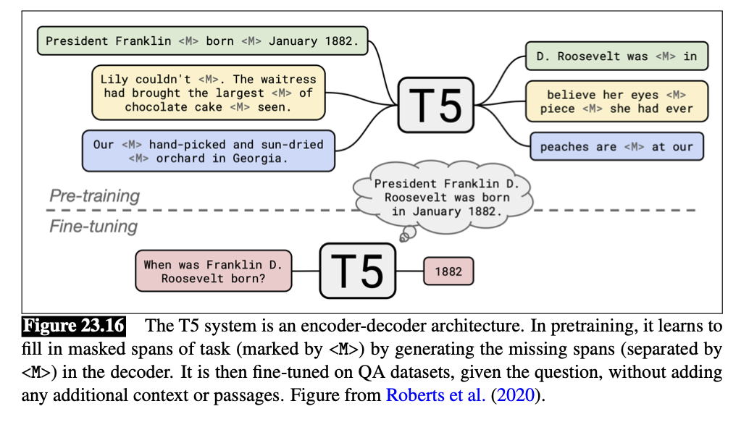
Language Model – based QA
Query a pre-trained language model (LM)
T5 LM: encoder-decoder based architecture

Slide 35
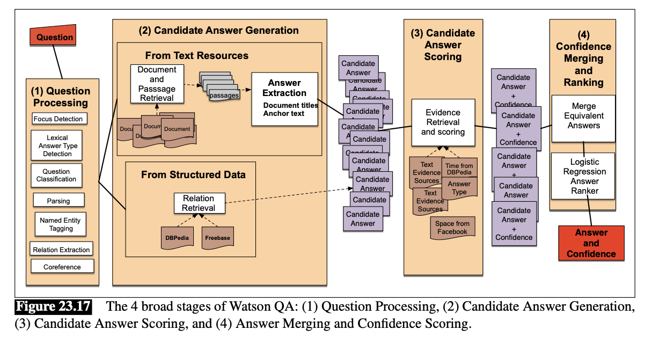
Classic QA model
Watson DeepQA system that won Jeopardy! In 2011

Slide 36
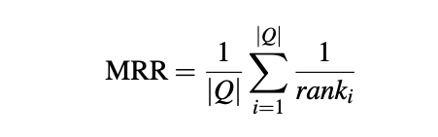
Evaluation of QA models
Mean reciprocal rank
For systems that return a short ranked list of answers or passages for each test question
The reciprocal of the rank of the first correct answer
MRR is the average of the scores for each question in the test set

Slide 37
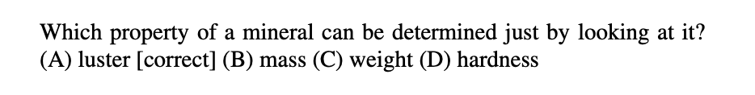
Evaluation of QA models
Other metrics (ignoring punctuations and articles like a, an, the)
Exact match: The % of predicted answers that match the gold answer exactly
F1 score: The average word/token overlap between predicted and gold answers
Test sets
TREC QA dataset
AI2 reasoning challenge (multiple choice questions that are hard to answer using simple lexical methods)
Notes:
in which the correct answer luster is unlikely to co-occur frequently with phrases like looking at it, while the word mineral is highly associated with the incorrect answer hardness.

